Slide 1
IF223 - Algorithmique Distribuée 2021-2022
Rohan Fossé - rohan.fosse@labri.fr
Notes:
‹#›

Slide 2
Graph Theory : Reminder
Notes:
‹#›

Slide 3
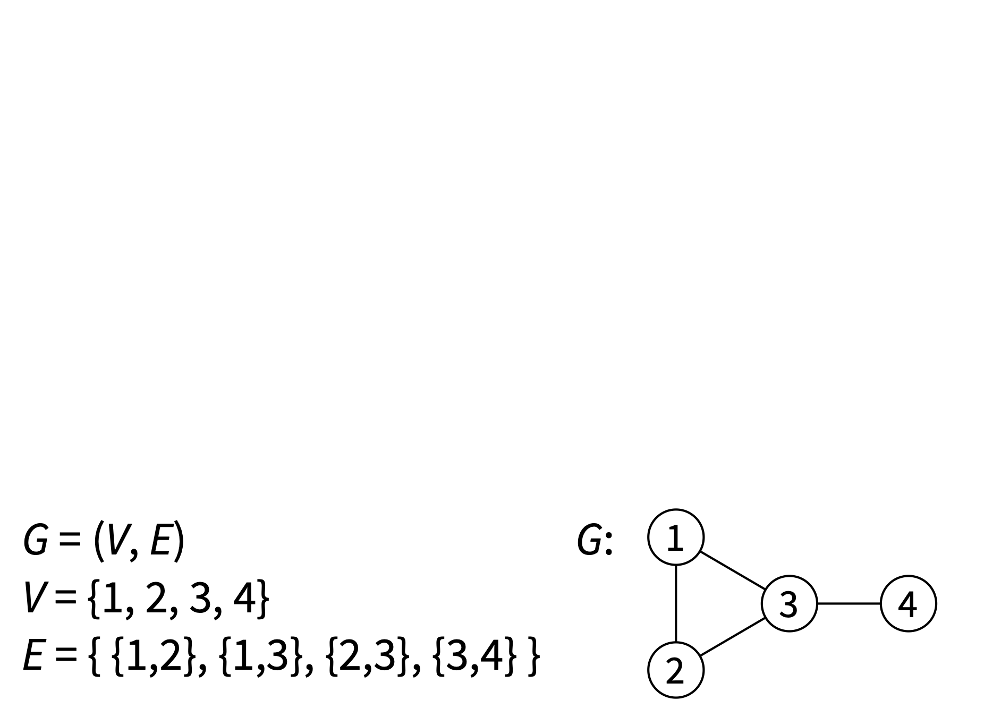
Graph G = (V, E)
V = set of nodes (finite, non-empty) E = set of edges (unordered pairs of nodes)

Slide 4
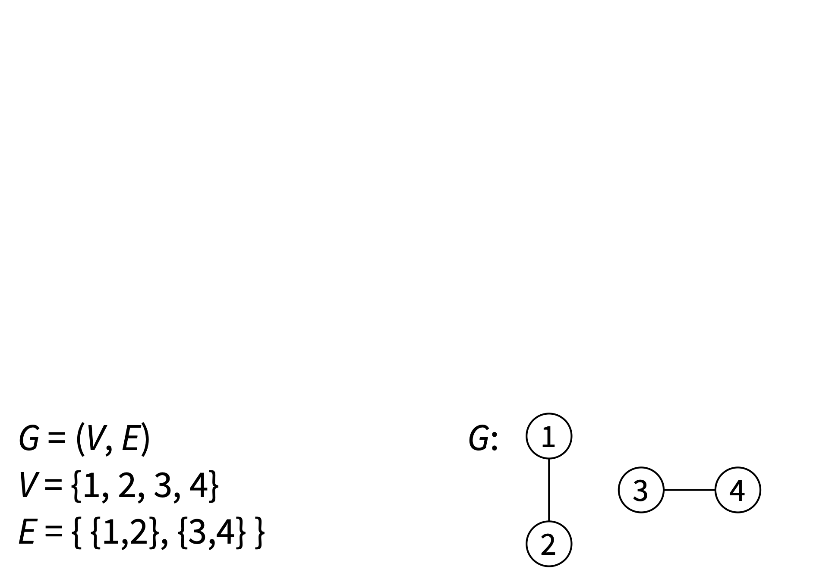
Graph G = (V, E)
V = set of nodes (finite, non-empty) E = set of edges (unordered pairs of nodes)

Slide 5
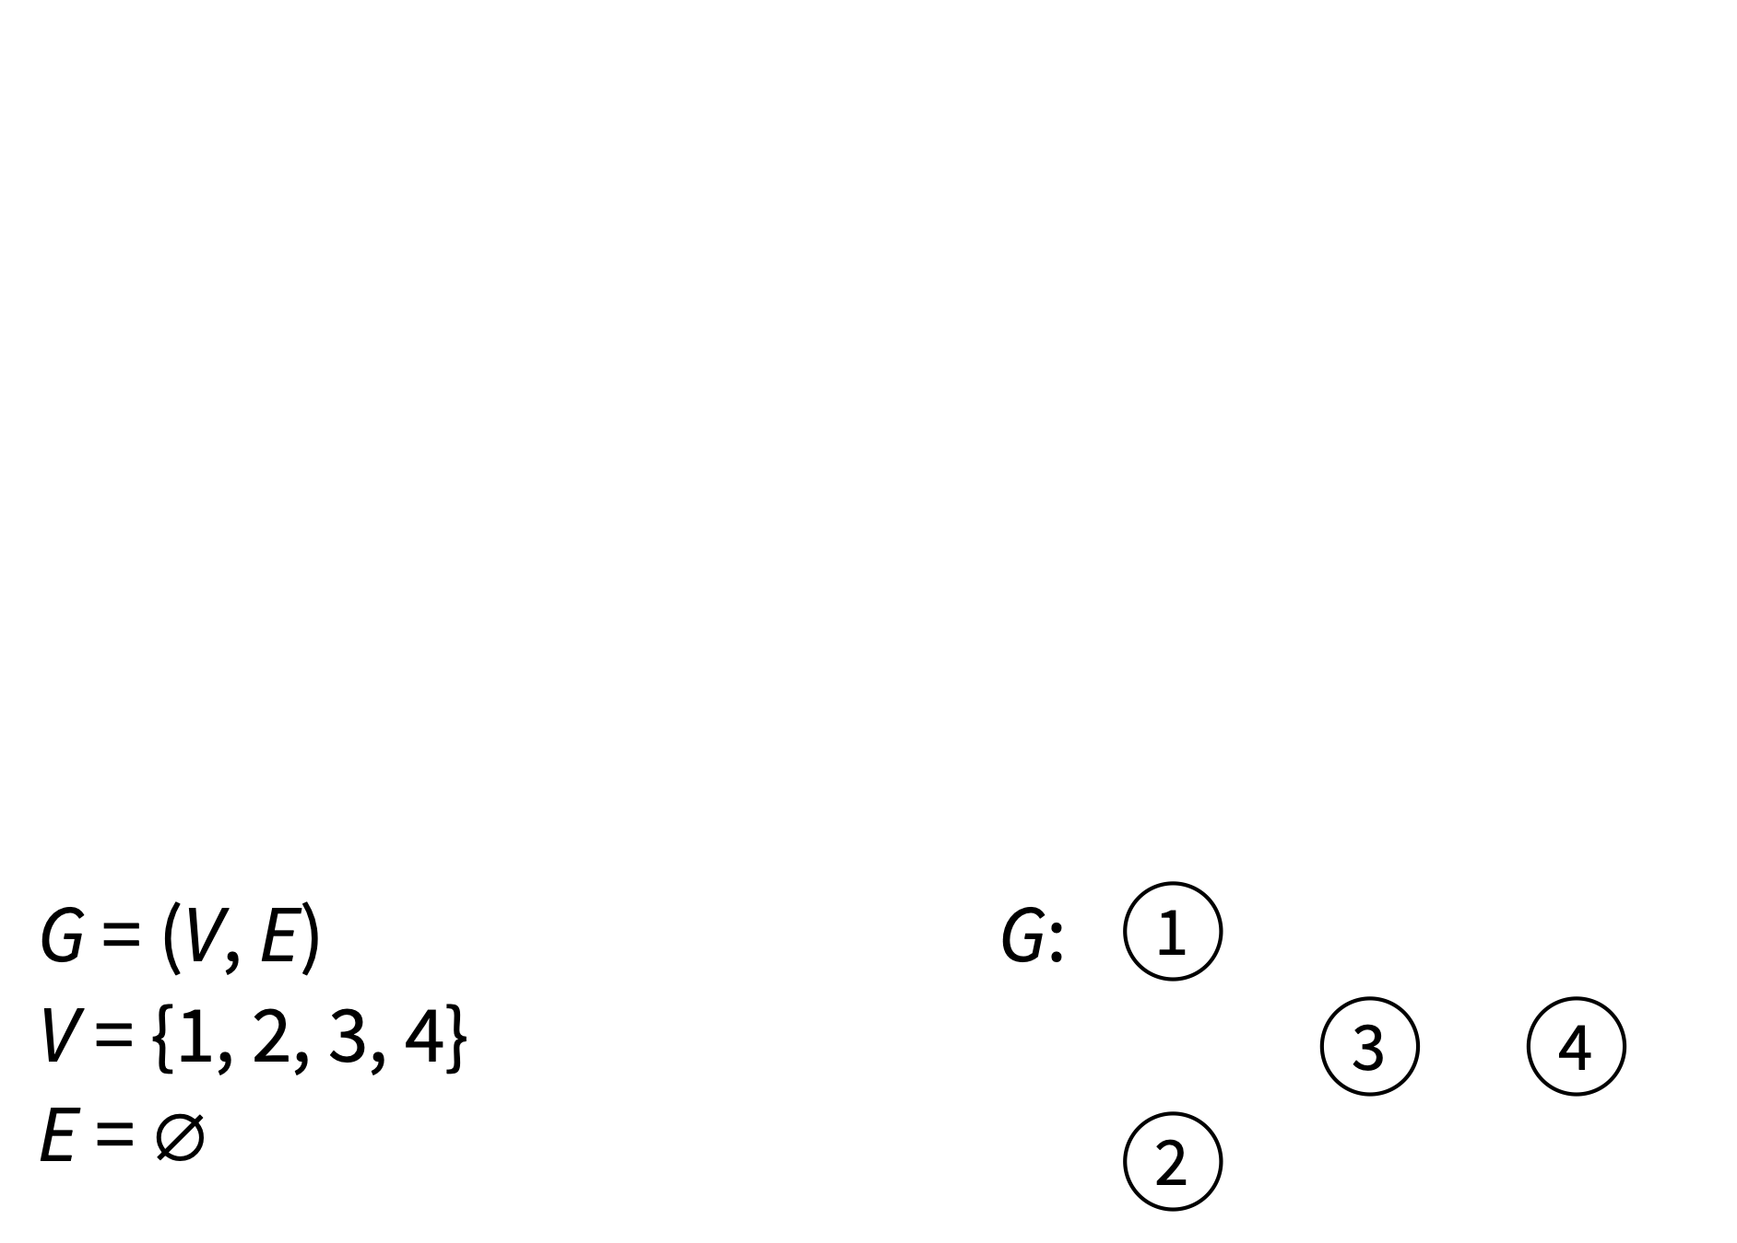
Graph G = (V, E)
V = set of nodes (finite, non-empty) E = set of edges (unordered pairs of nodes)

Slide 6
Graph G = (V, E)
V = set of nodes (a.k.a. “vertices”) E = set of edges
Usually nodes are denoted with u, v (if more nodes needed: s, t, u, v, u’, v’, v₁, v₂, etc.), edges are denoted with e, e’, e₁, e₂, etc.
Convention: n = |V|, m = |E|

Slide 7
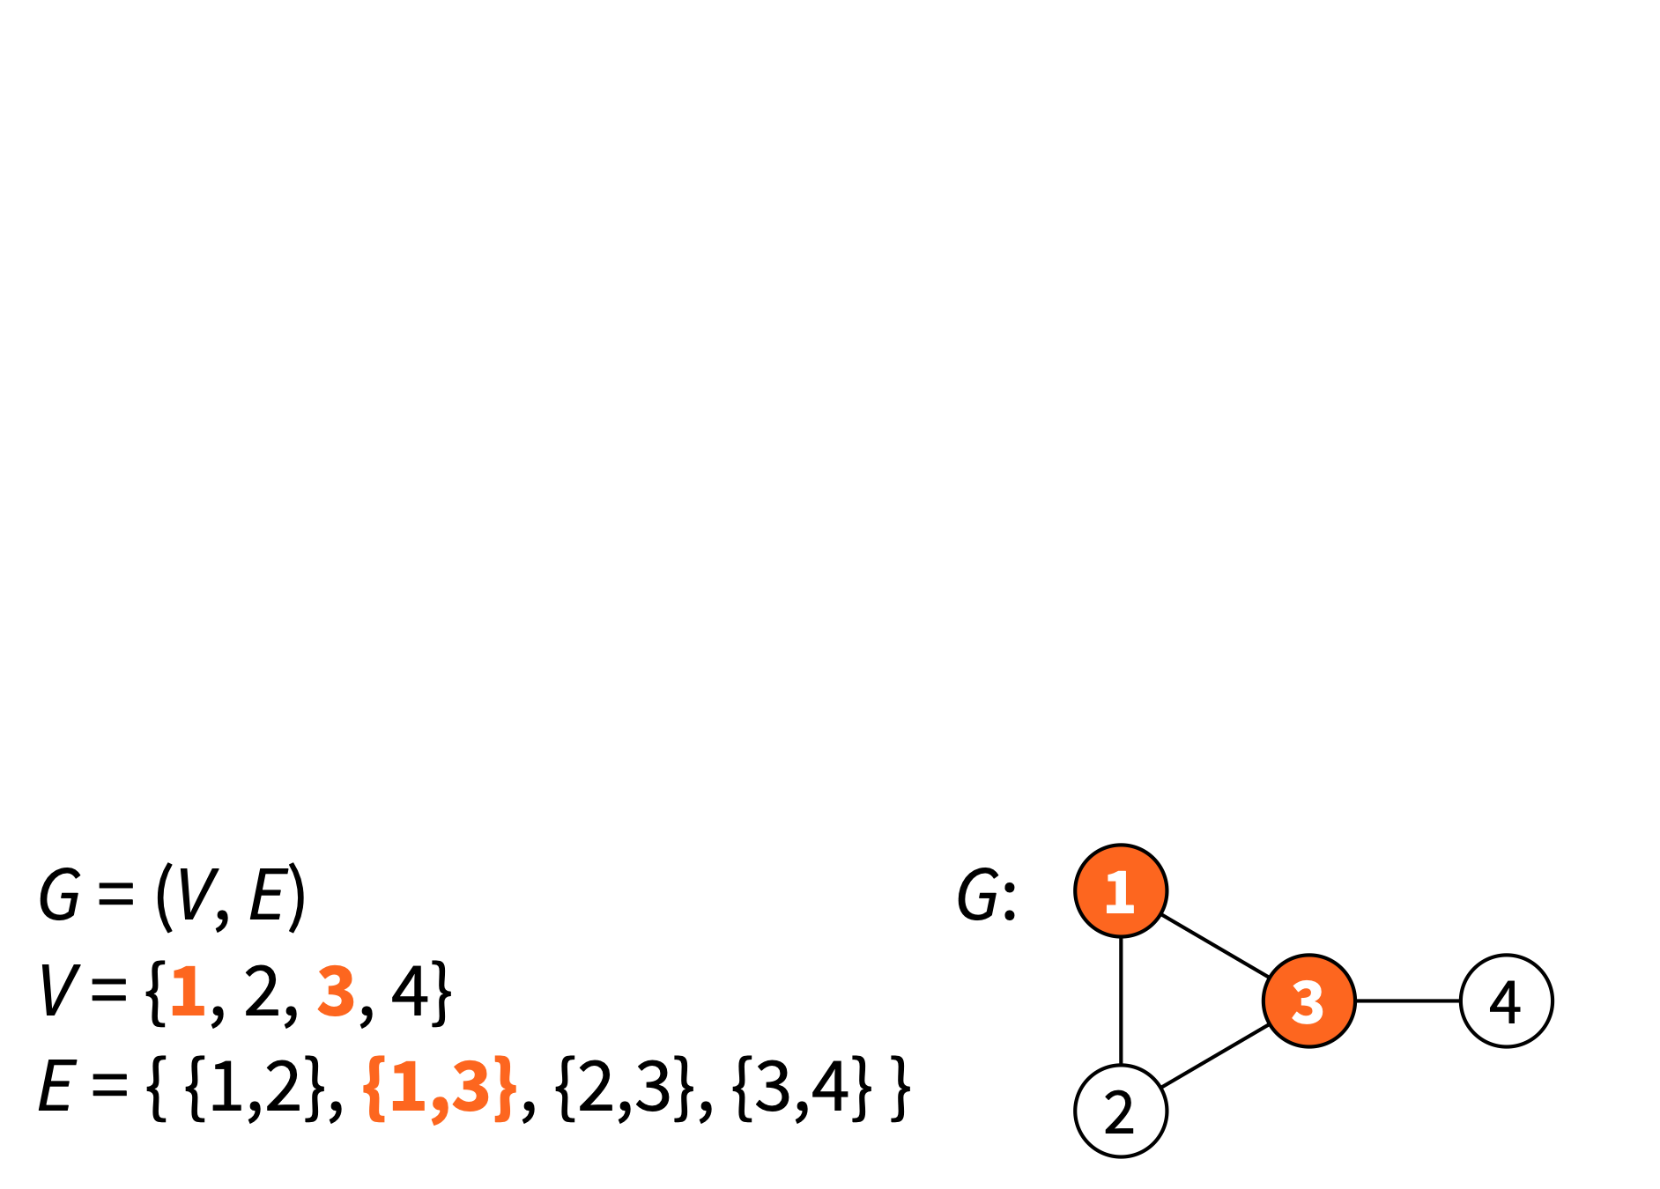
Graph G = (V, E)
u and v are adjacent nodes = nodes u and v are neighbours = there is an edge {u, v}

Slide 8
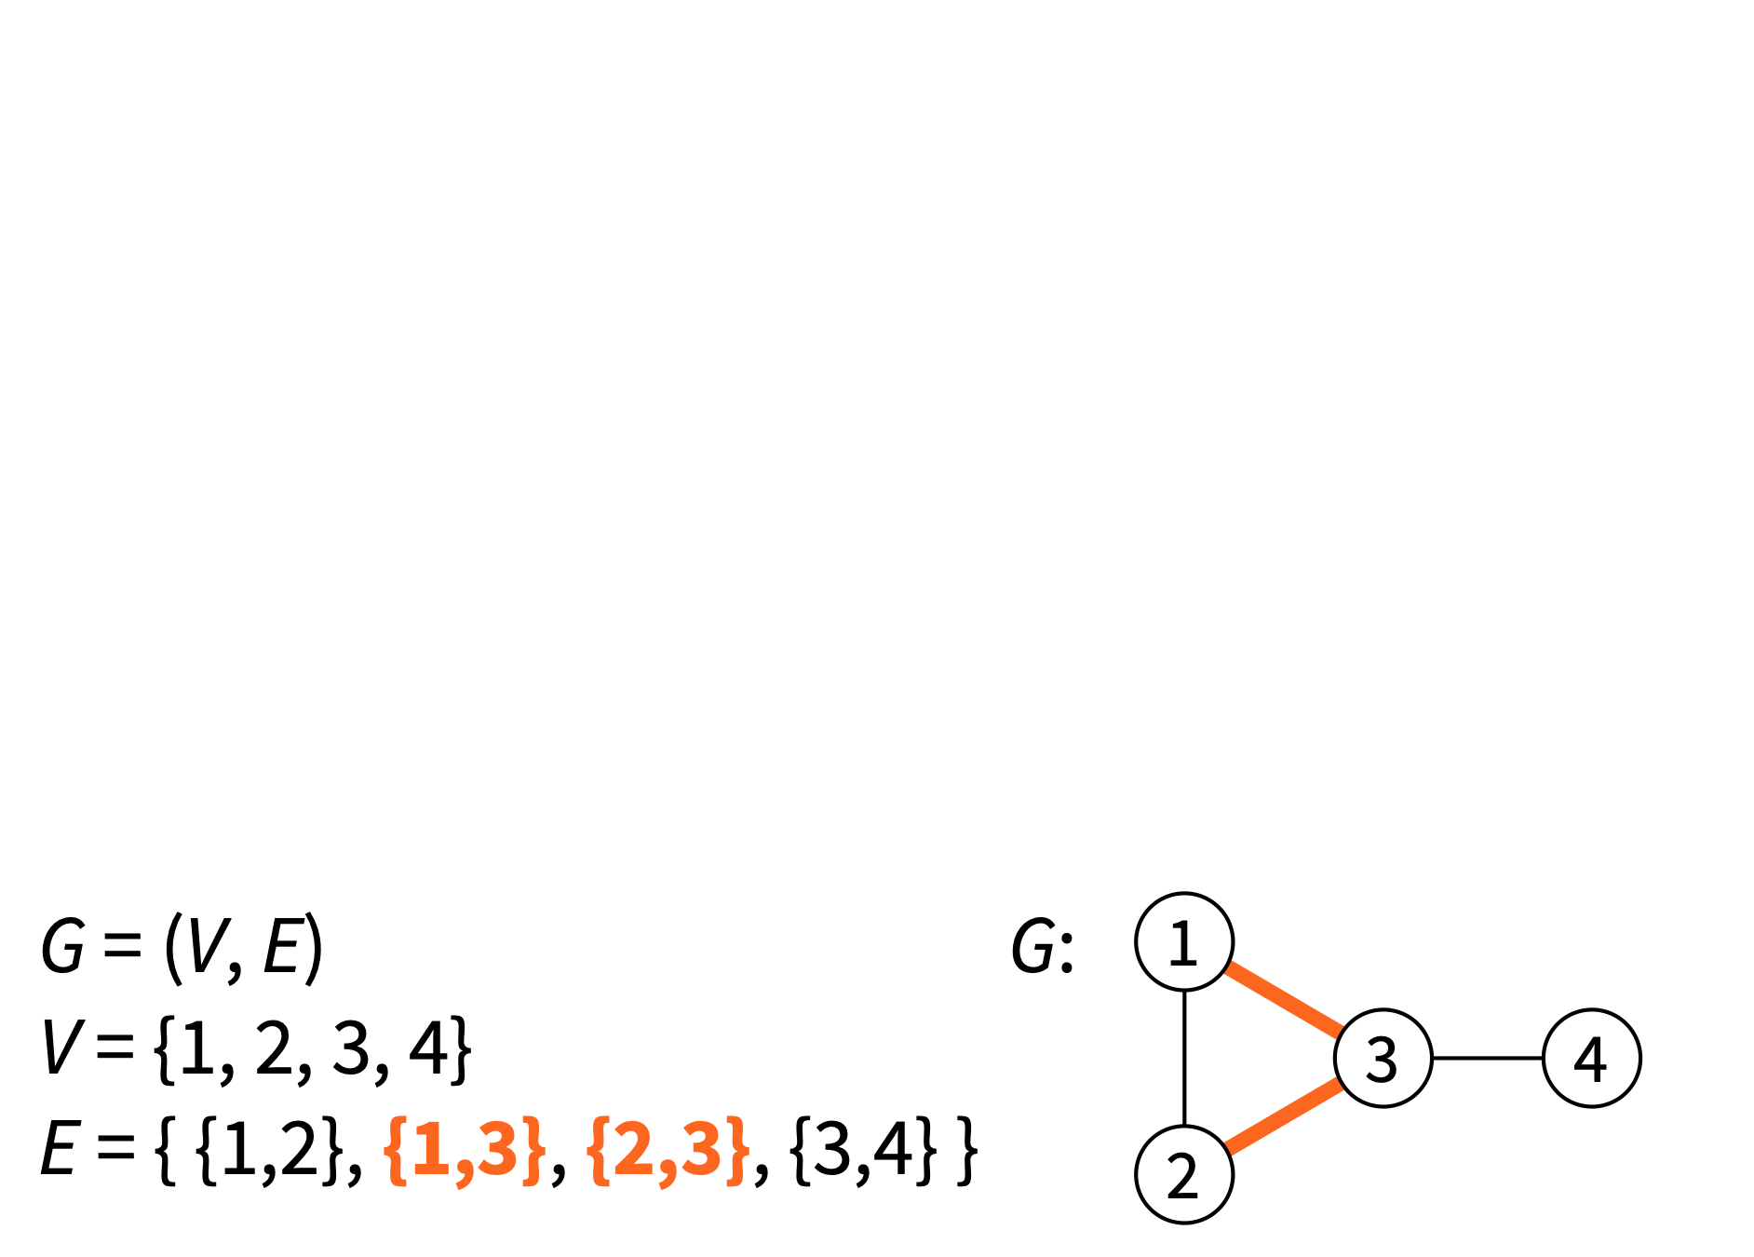
Graph G = (V, E)
e₁ and e₂ are “adjacent edges” = they share an endpoint = their intersection is non-empty

Slide 9
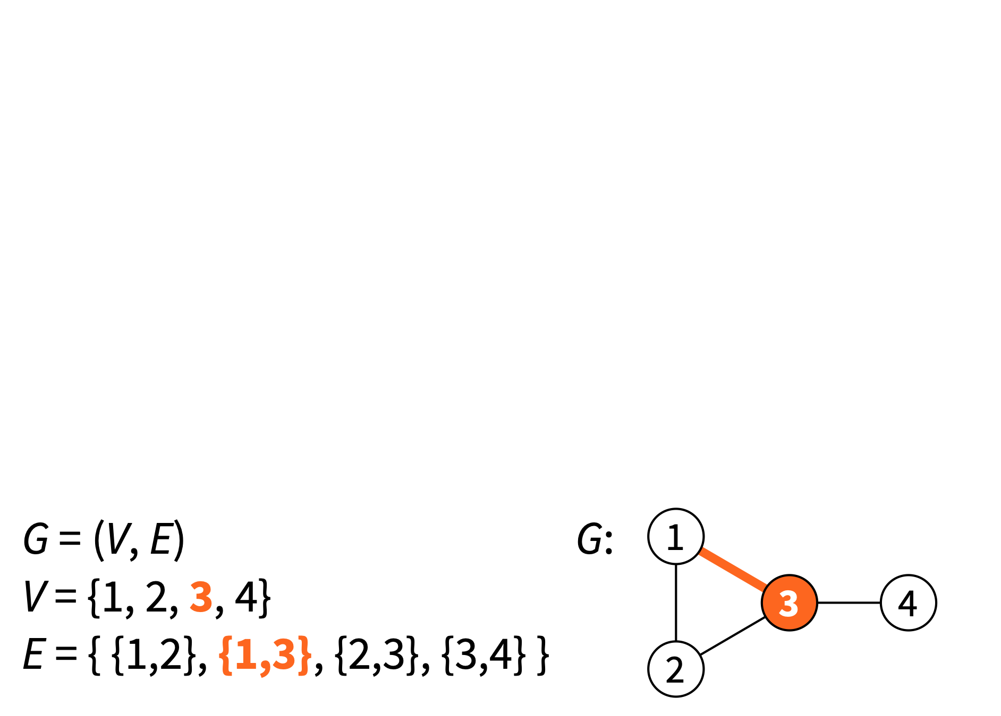
Graph G = (V, E)
Node v is incident to edge e = v is an endpoint of e = v is a member of e

Slide 10
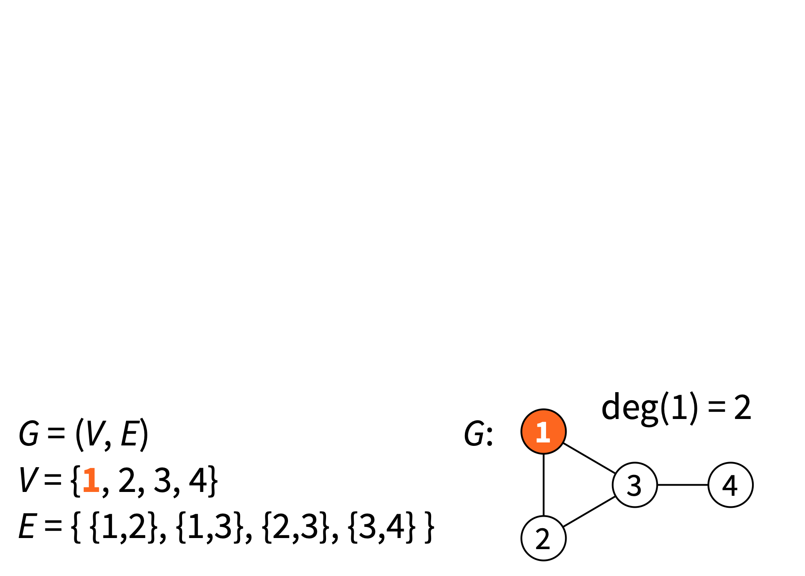
Graph G = (V, E)
Node of degree k = # node adjacent to k nodes = # node incident to k edges

Slide 11
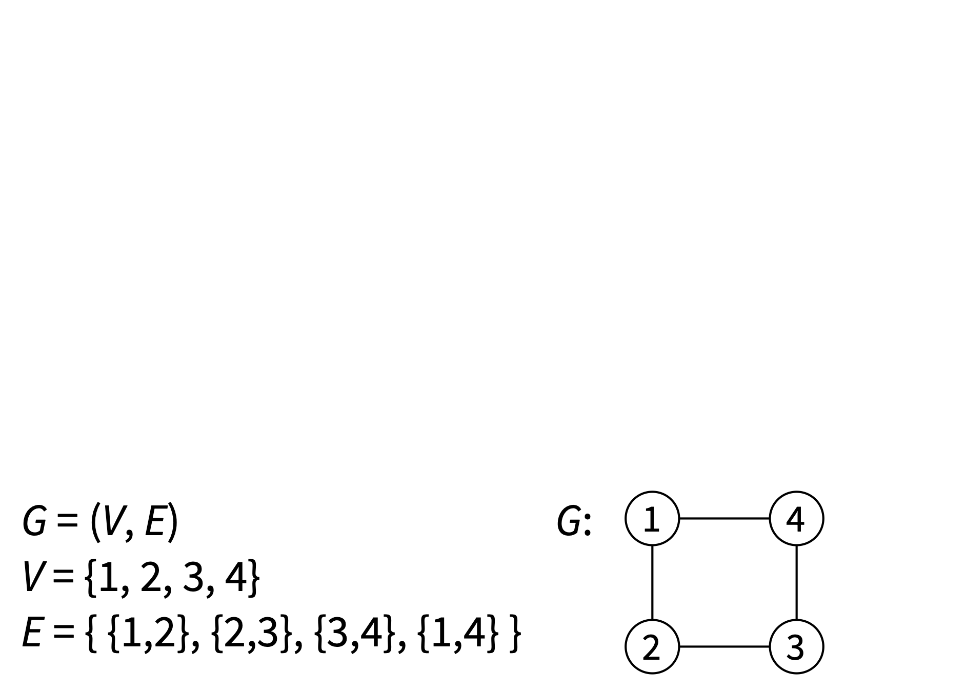
Graph G = (V, E)
k-regular graph = all nodes have degree k = all nodes have k neighbours

Slide 12
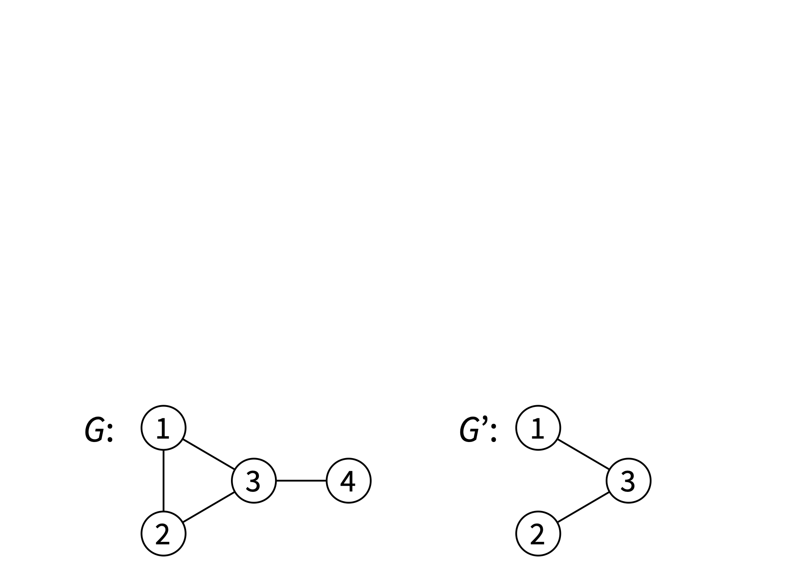
Subgraph
Graph G’ = (V’, E’) is a subgraph of G = (V, E): V’ ⊆ V and E’ ⊆ E

Slide 13
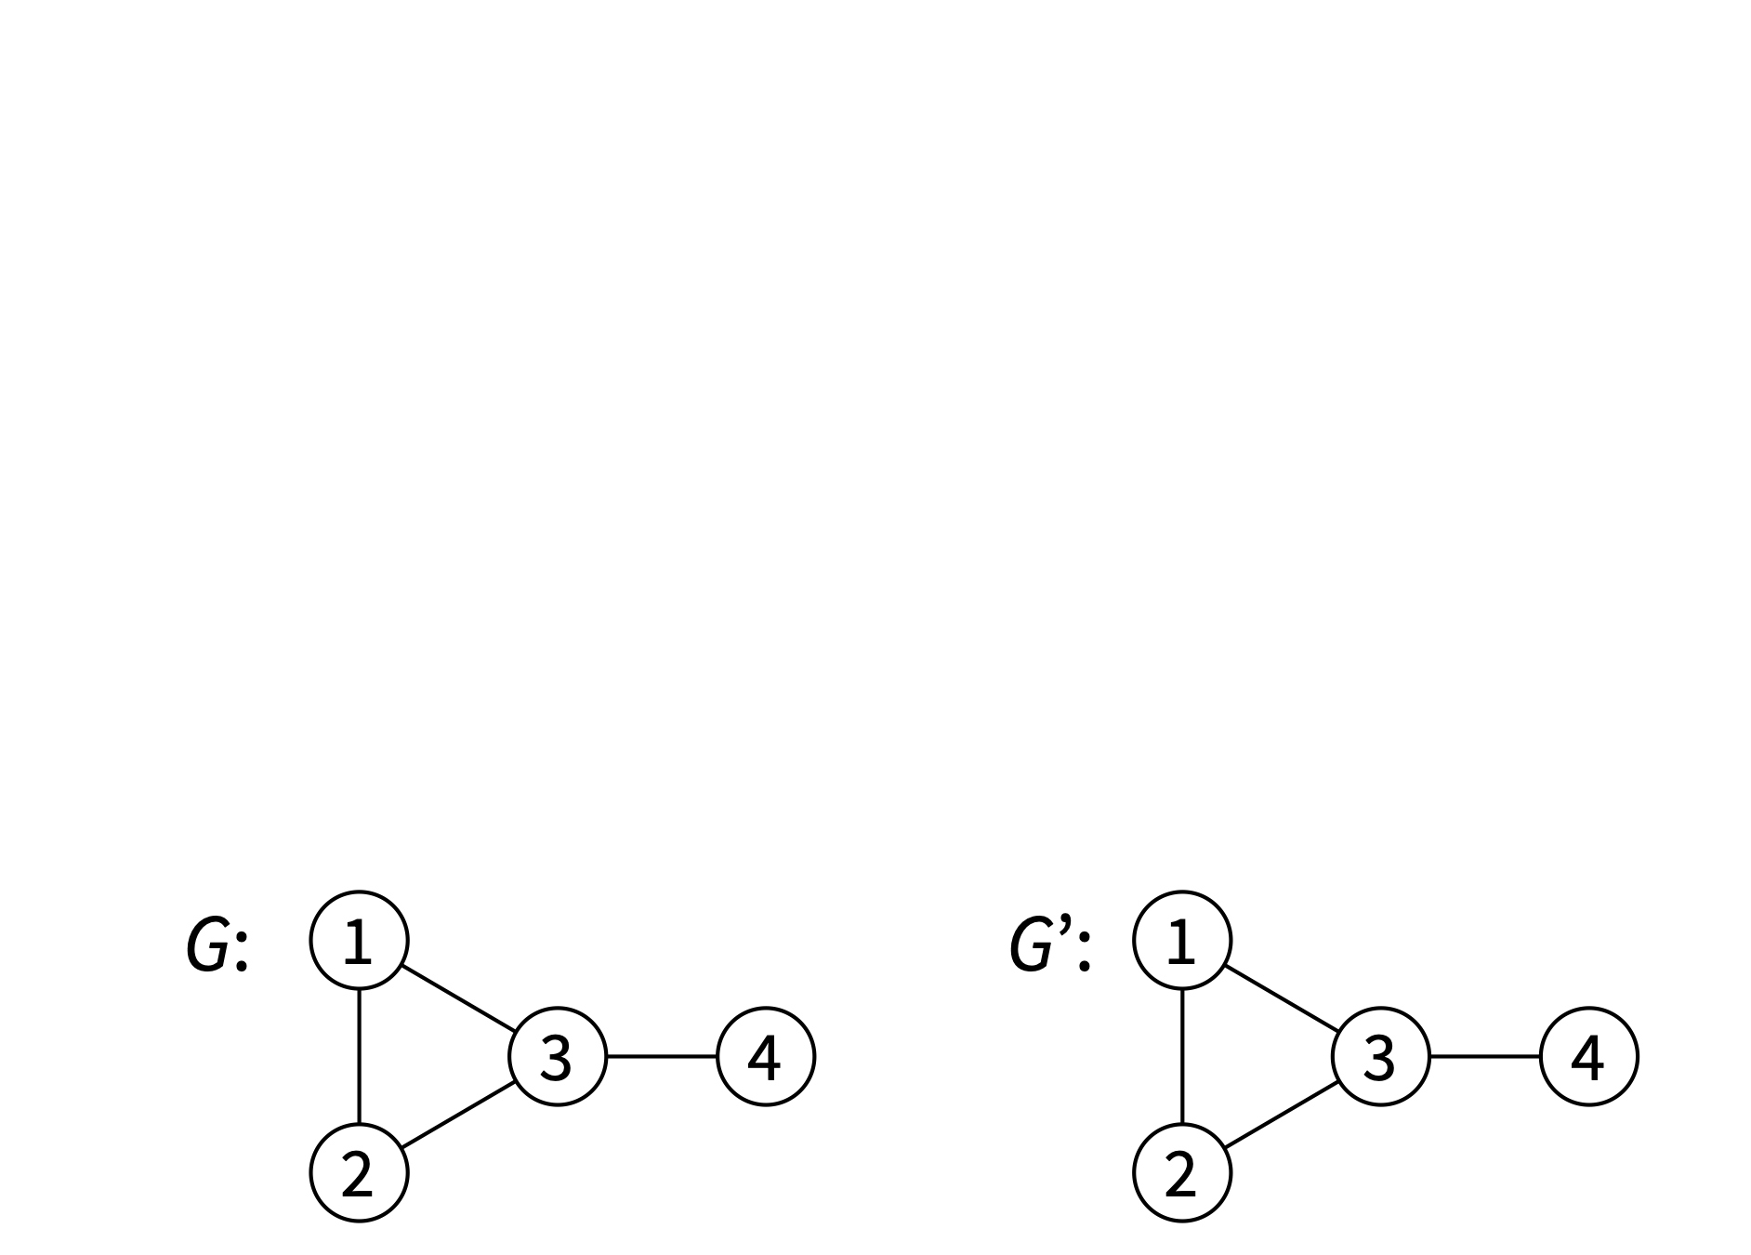
Subgraph
Graph G’ = (V’, E’) is a subgraph of G = (V, E): V’ ⊆ V and E’ ⊆ E

Slide 14
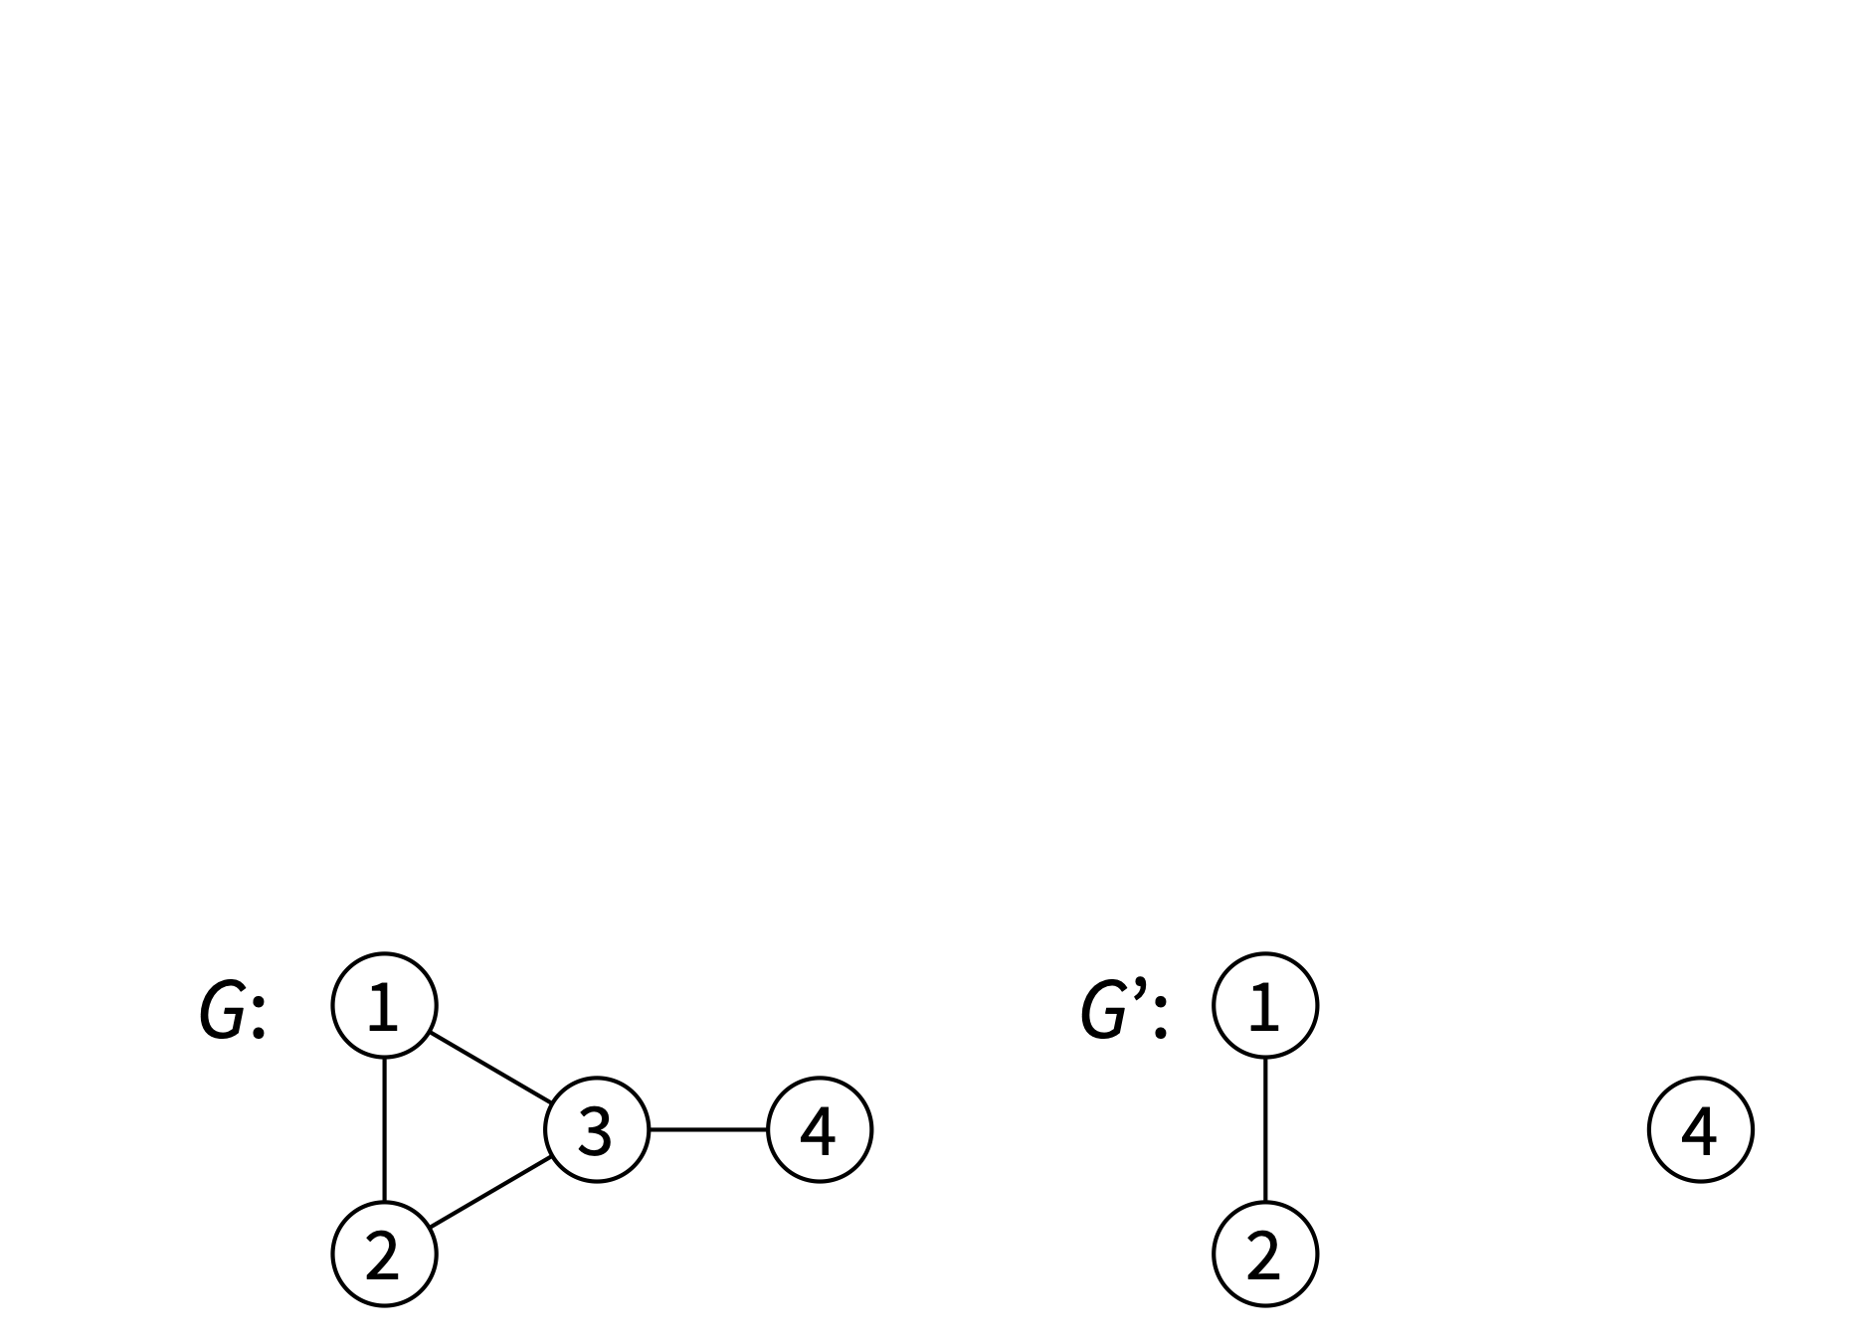
Subgraph
Graph G’ = (V’, E’) is a subgraph of G = (V, E): V’ ⊆ V and E’ ⊆ E

Slide 15
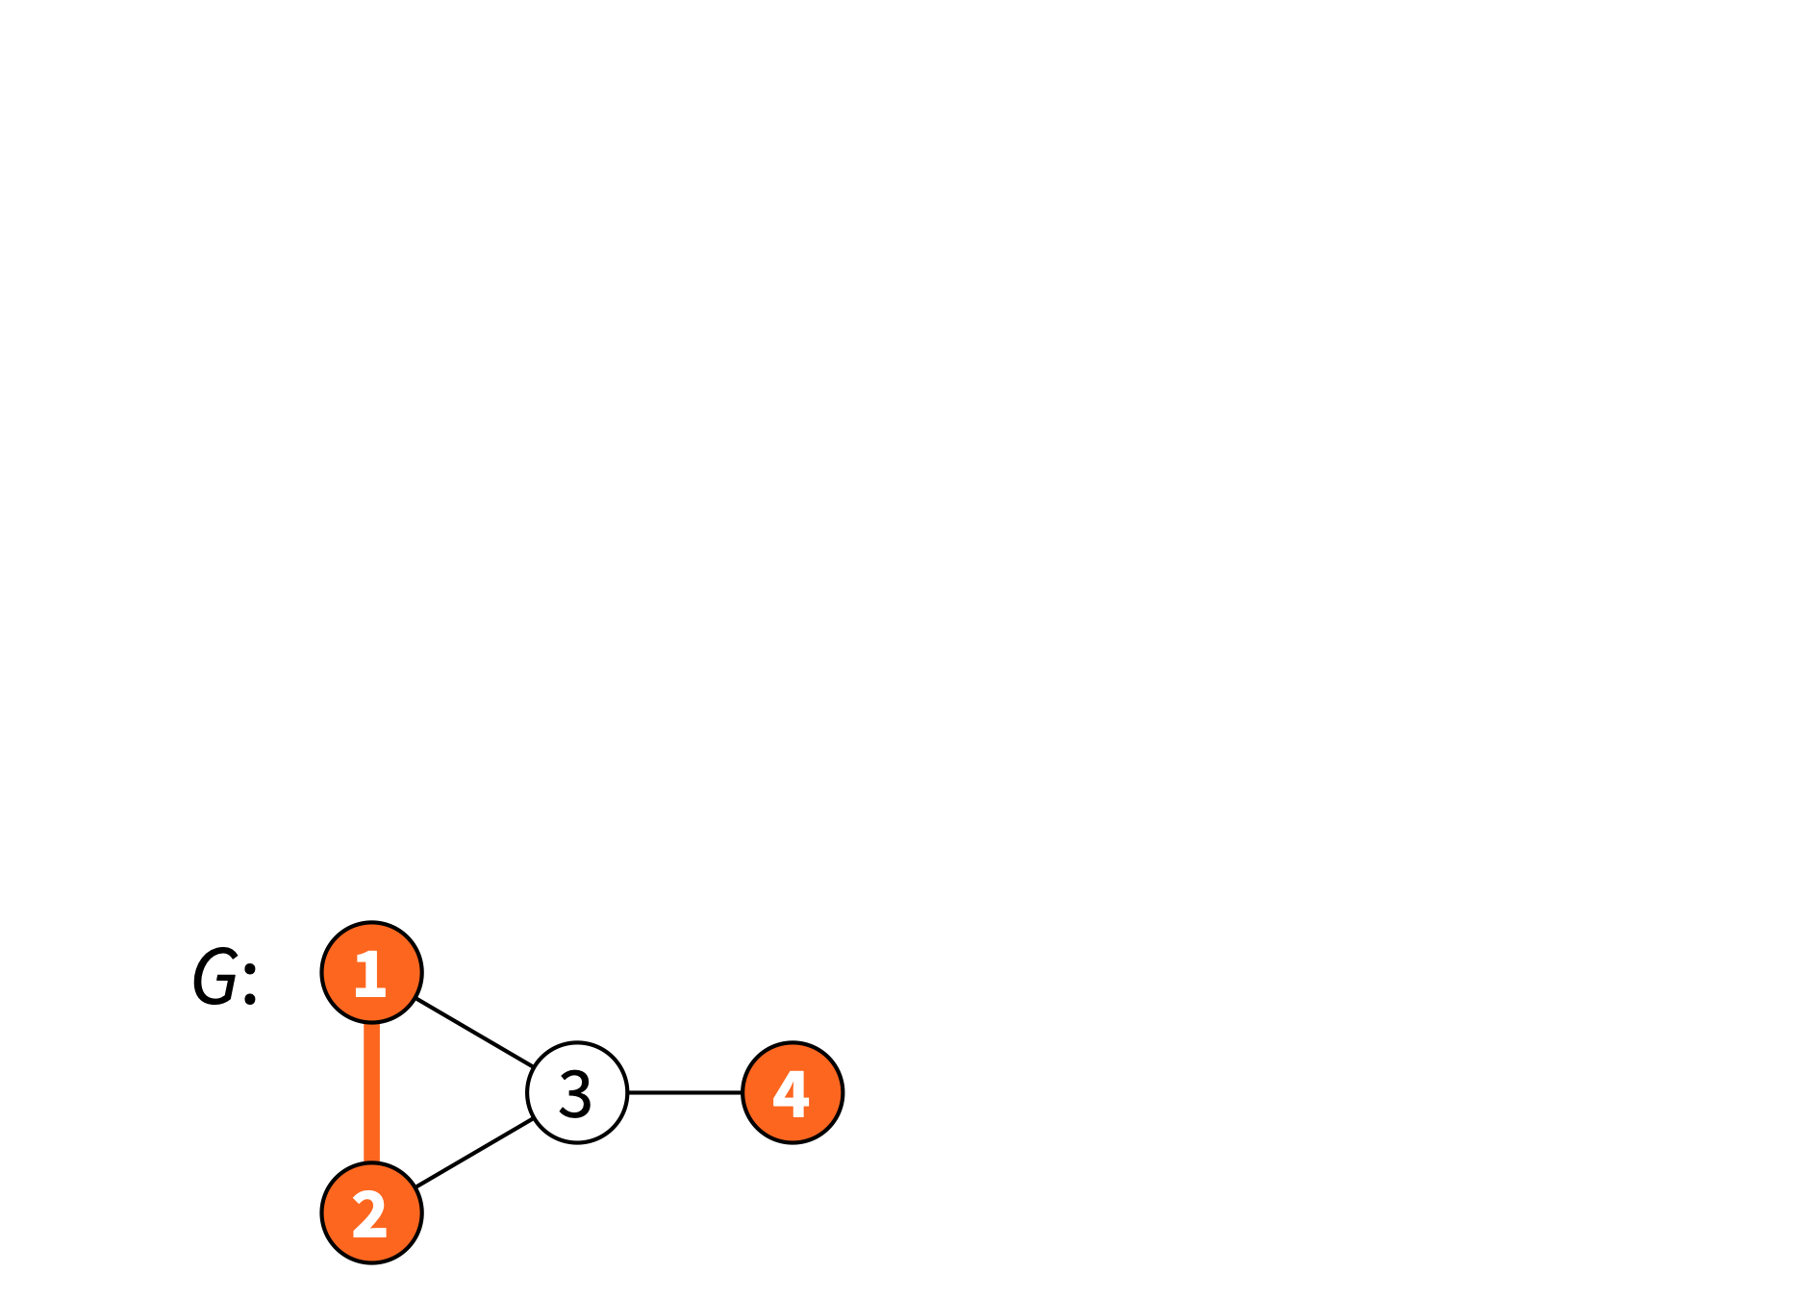
Subgraph
Graph G’ = (V’, E’) is a subgraph of G = (V, E): V’ ⊆ V and E’ ⊆ E

Slide 16
Induced Subgraph
Subgraph induced by nodes V’ = all nodes of V’ and all edges that connect them

Slide 17
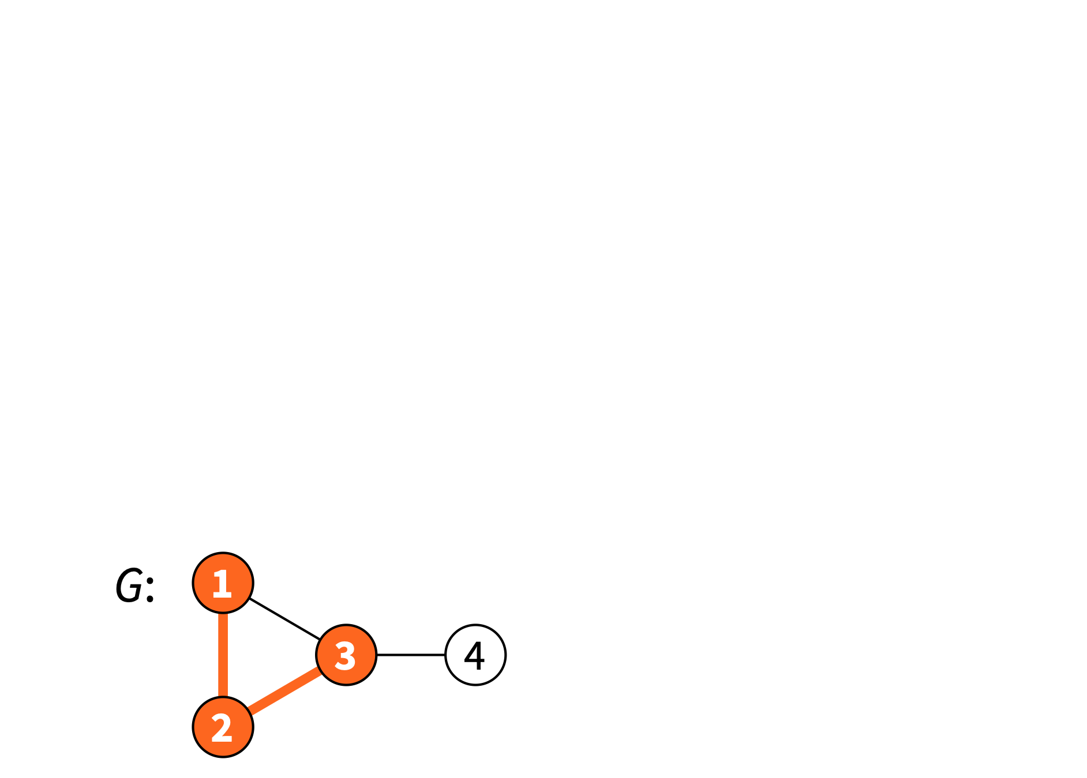
Induced Subgraph
Subgraph induced by edges E’ = all edges of E’ and all of their endpoints

Slide 18
Induced Subgraph
This is not a subgraph induced by any set of nodes — why?

Slide 19
Induced Subgraph
This is not a subgraph induced by any set of edges — why?

Slide 20
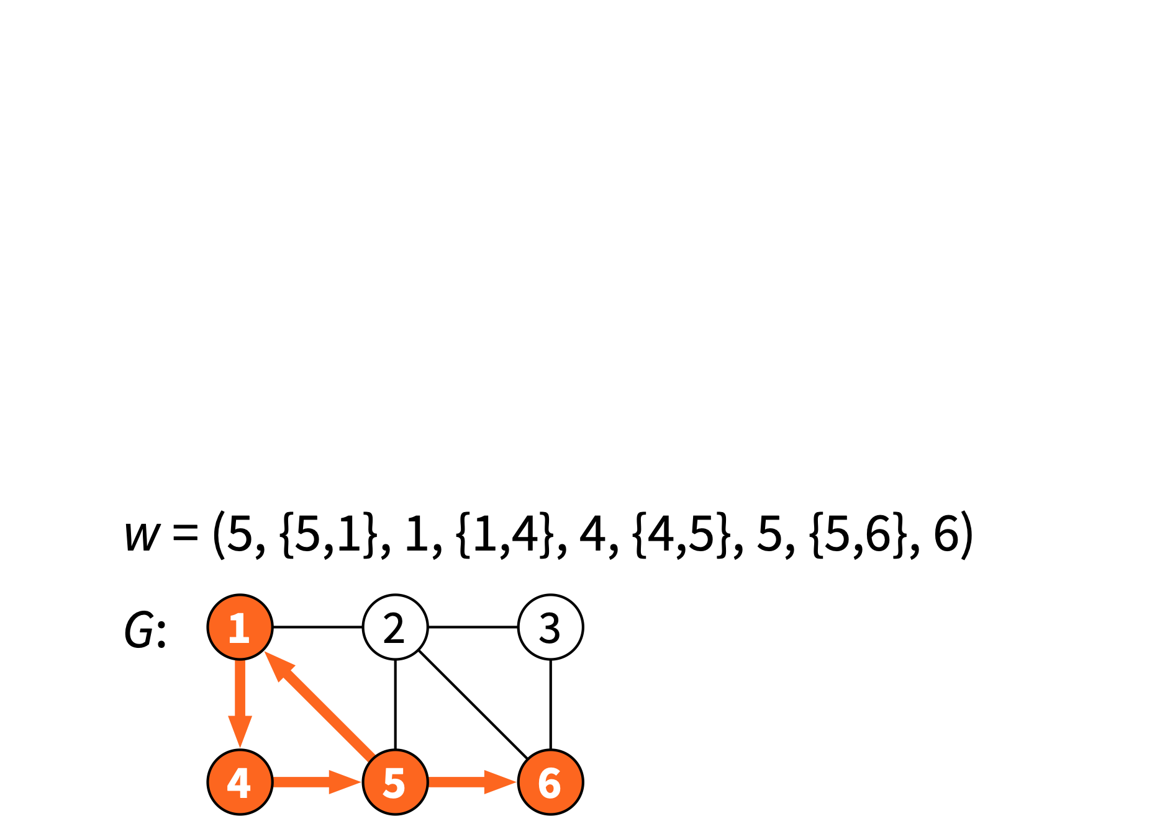
Walks, paths and connectivity
Walk = alternating sequence of incident nodes and edges

Slide 21
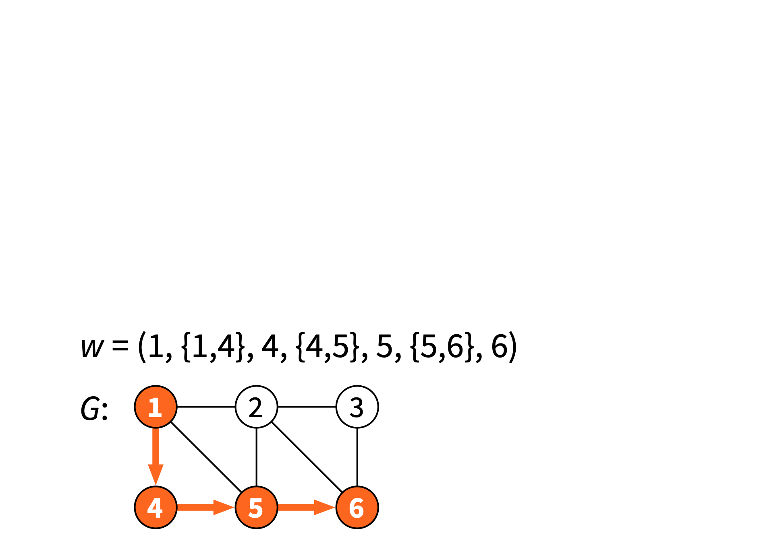
Walks, paths and connectivity
Path = walk visiting each node at most once
Length of a path = number of edges

Slide 22
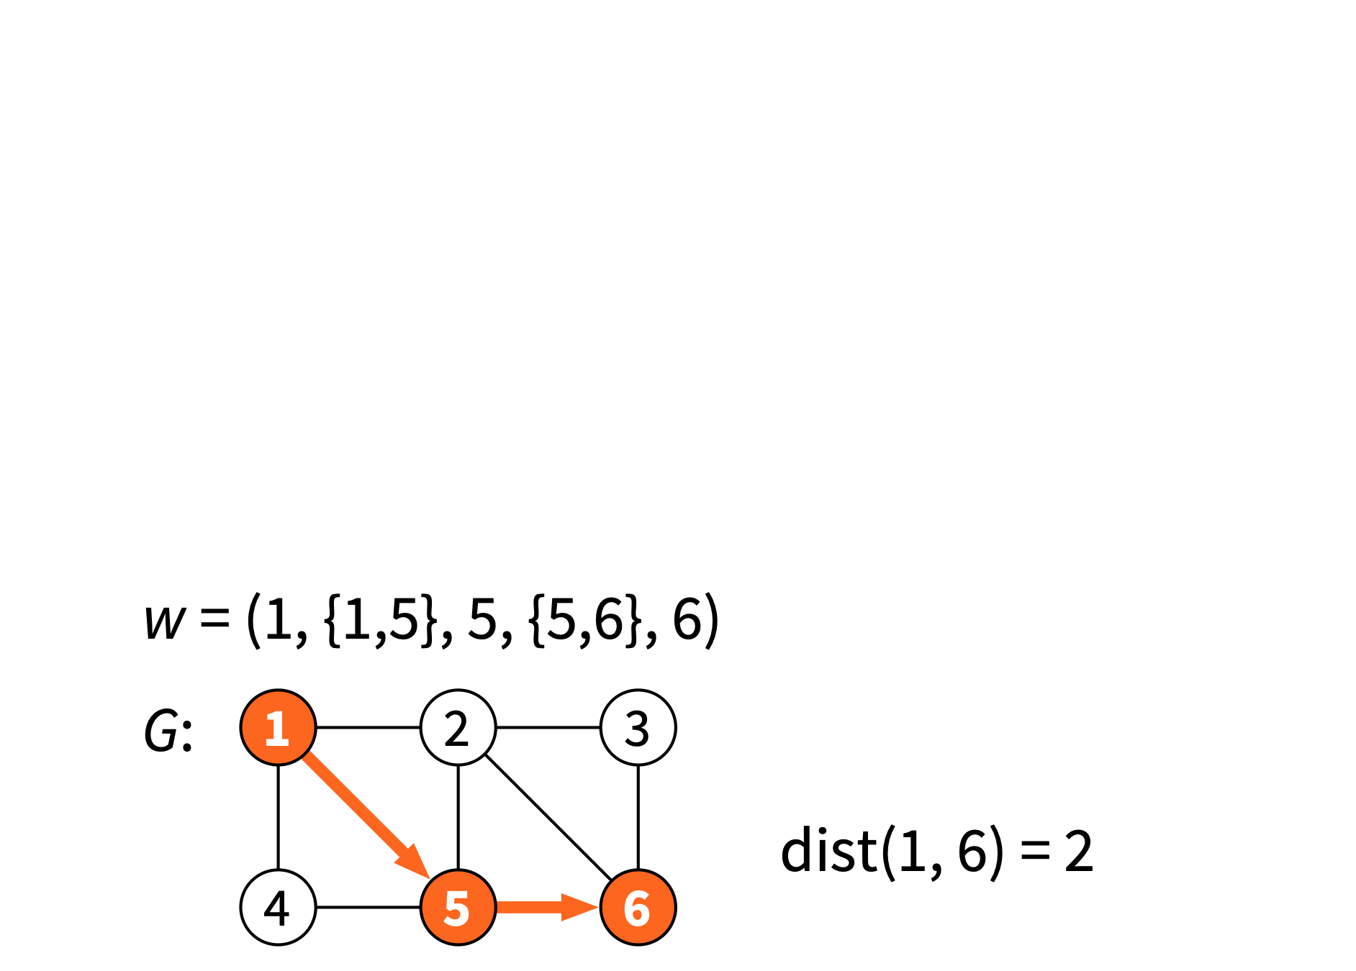
Walks, paths and connectivity
Distance = length of a shortest path

Slide 23
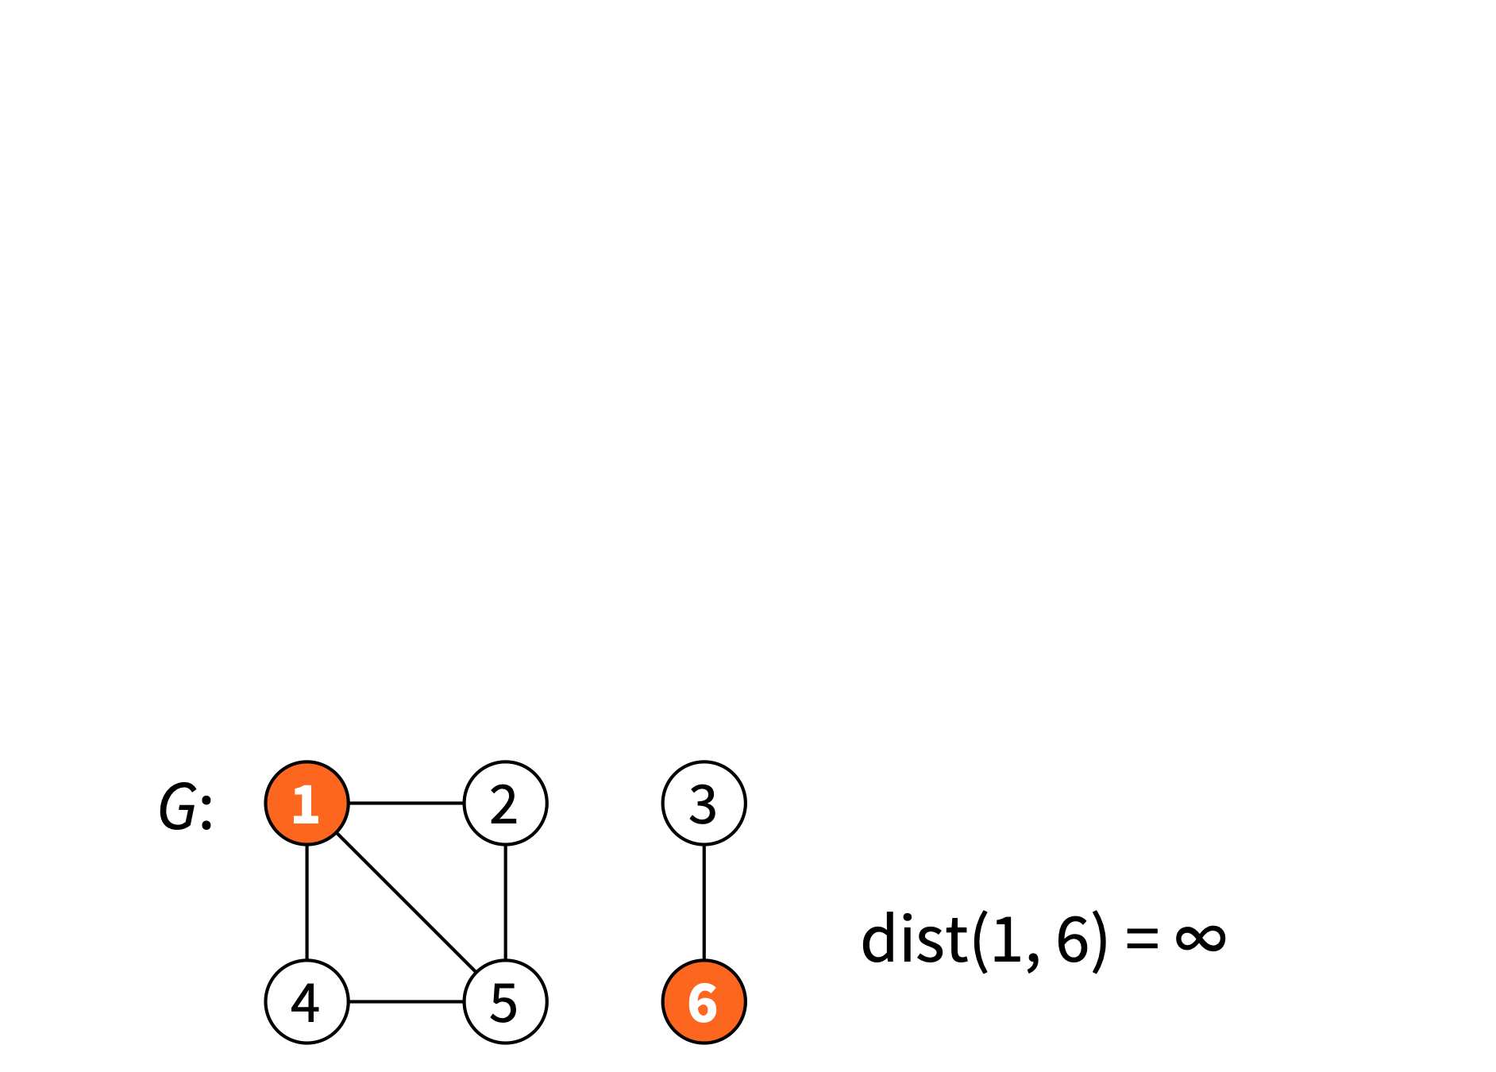
Walks, paths and connectivity
Distance = length of a shortest path (infinite if no such path exists)

Slide 24
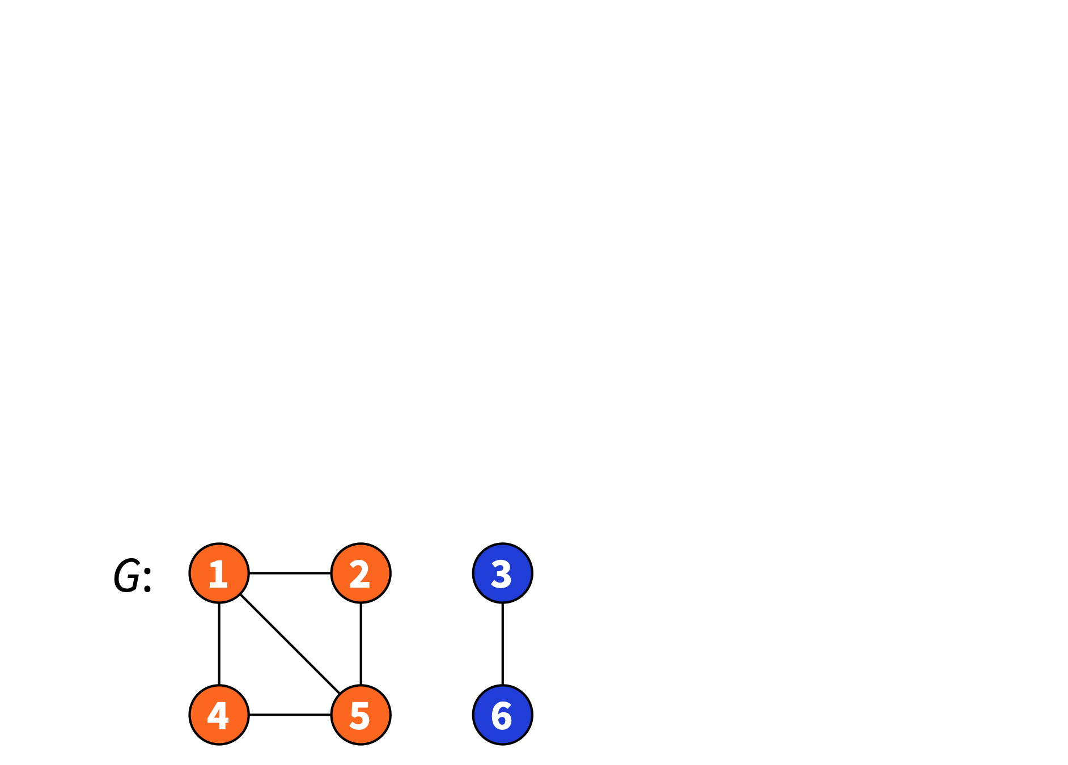
Walks, paths and connectivity
Connected component C: there is a path between any two nodes of C

Slide 25
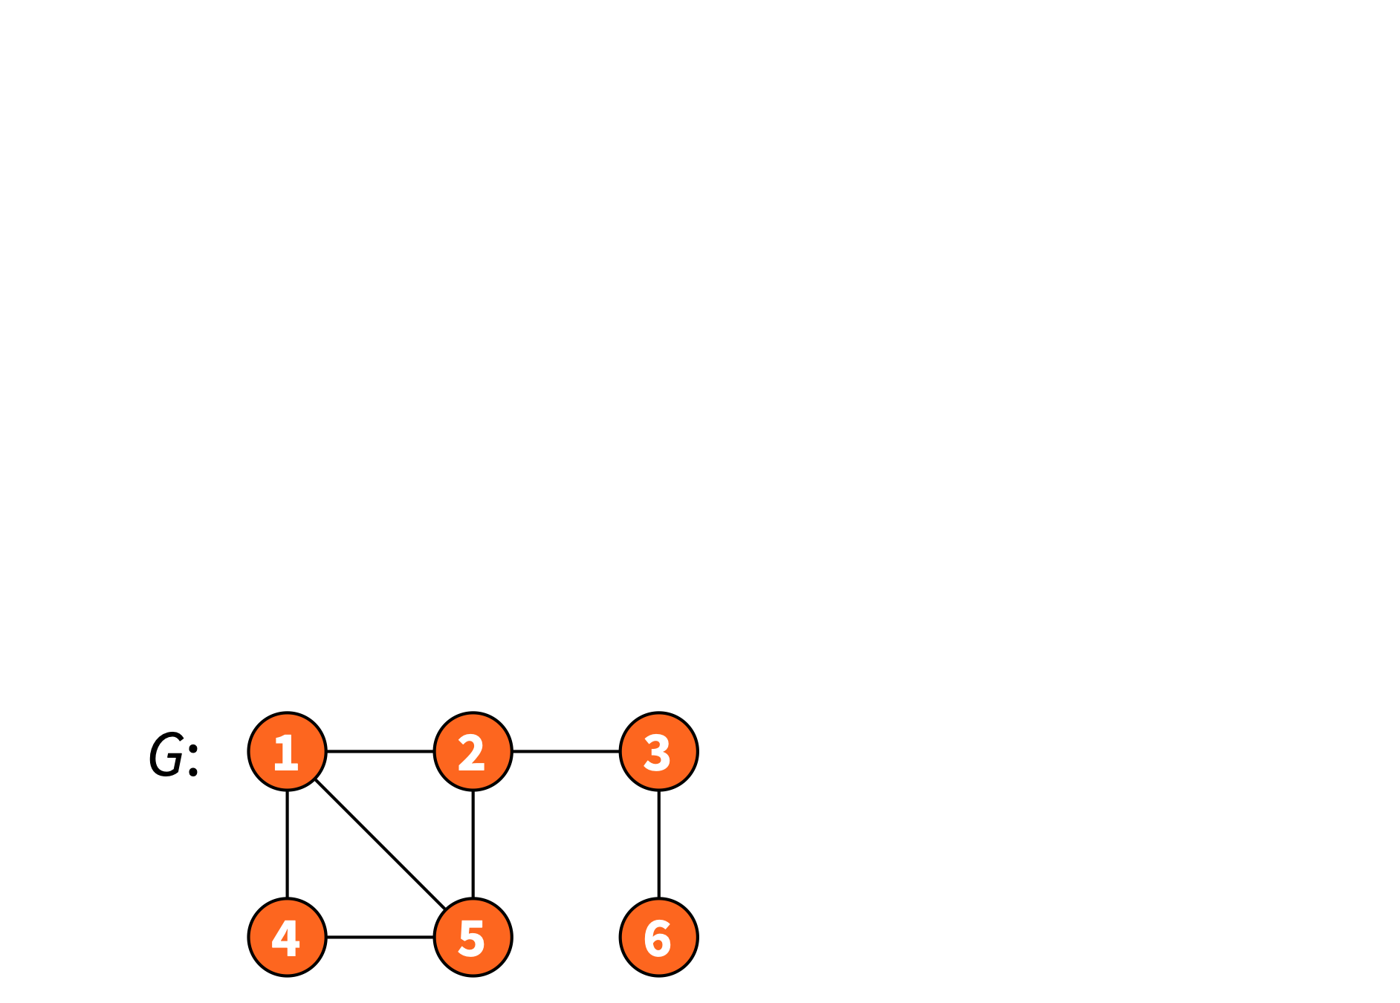
Walks, paths and connectivity
Graph is connected if only 1 connected component

Slide 26
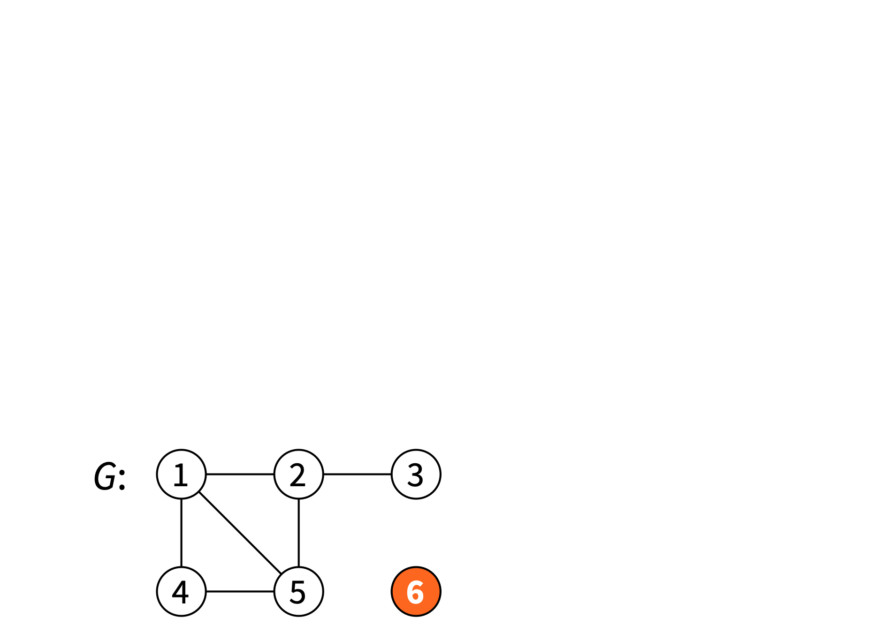
Walks, paths and connectivity
Isolated node = node of degree 0

Slide 27
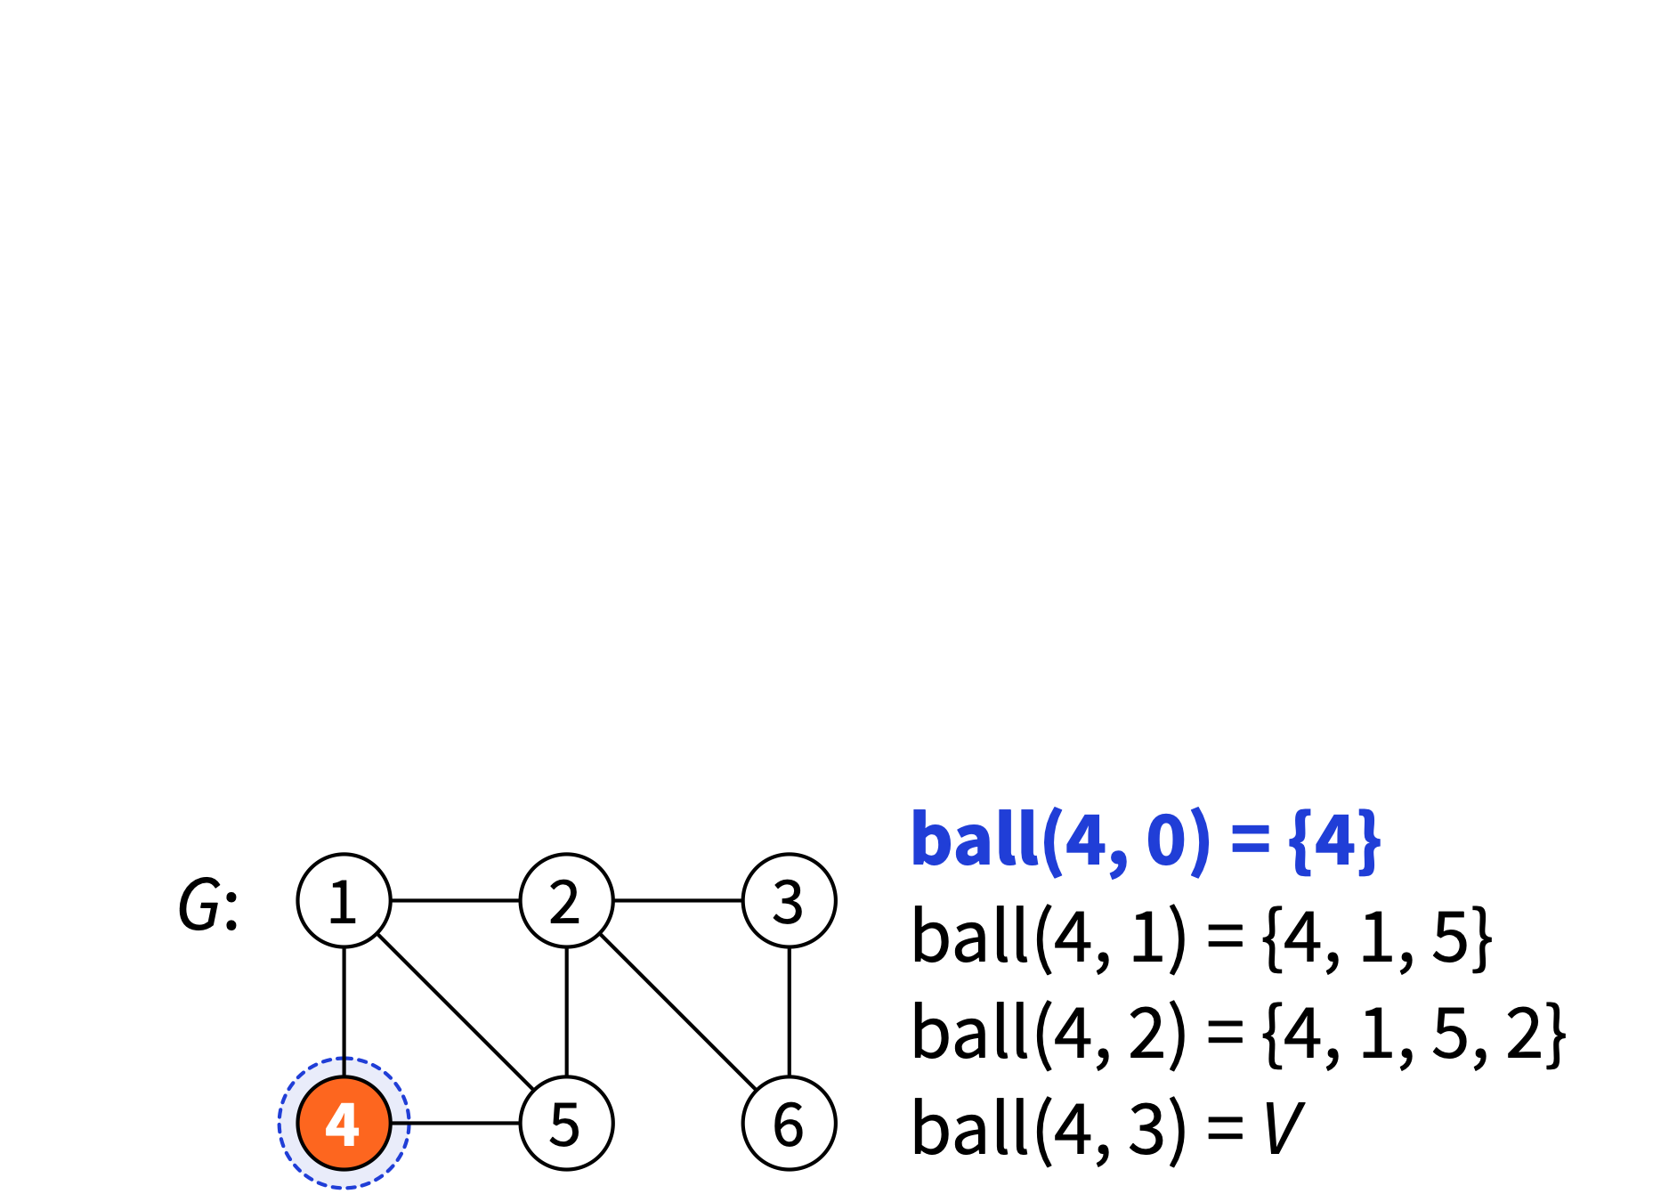
Walks, paths and connectivity
ball(v, r) = “radius-r neighbourhood of v” = nodes at distance at most r from node v

Slide 28
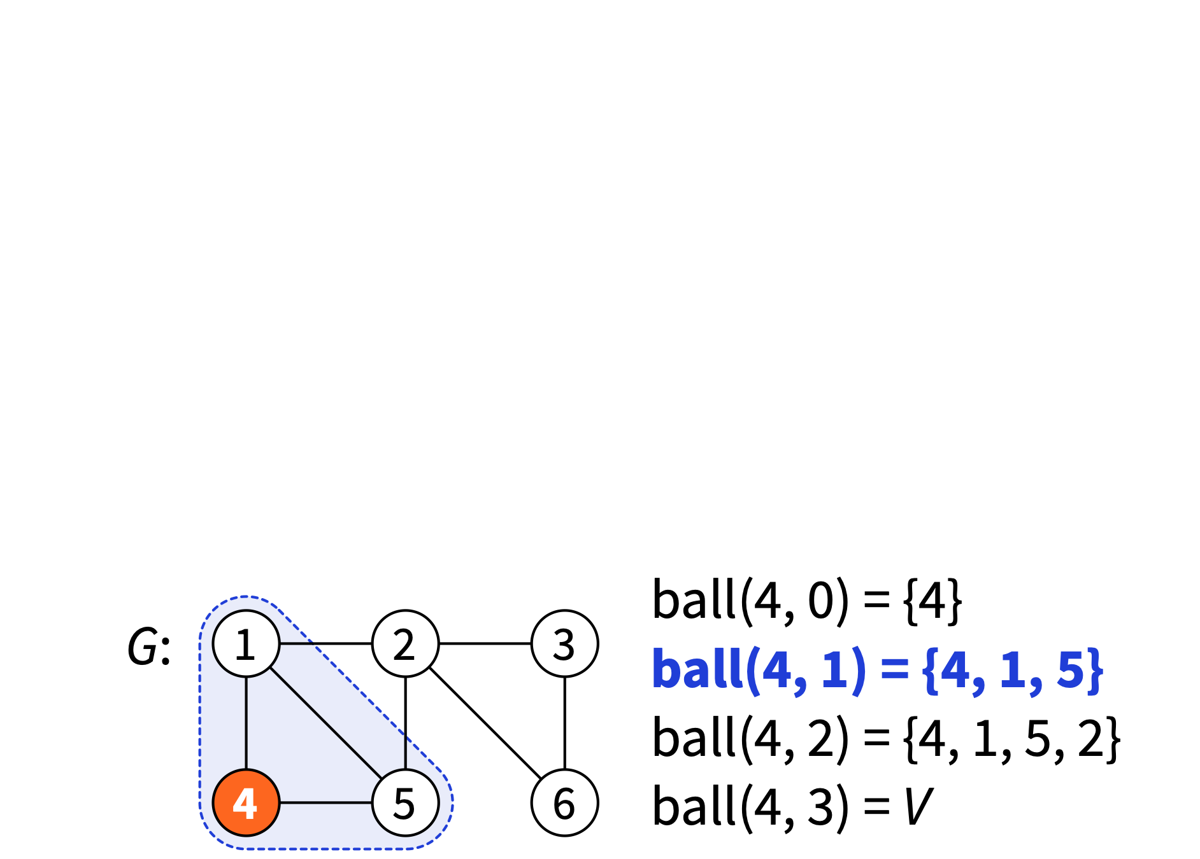
Walks, paths and connectivity
ball(v, r) = “radius-r neighbourhood of v” = nodes at distance at most r from node v

Slide 29
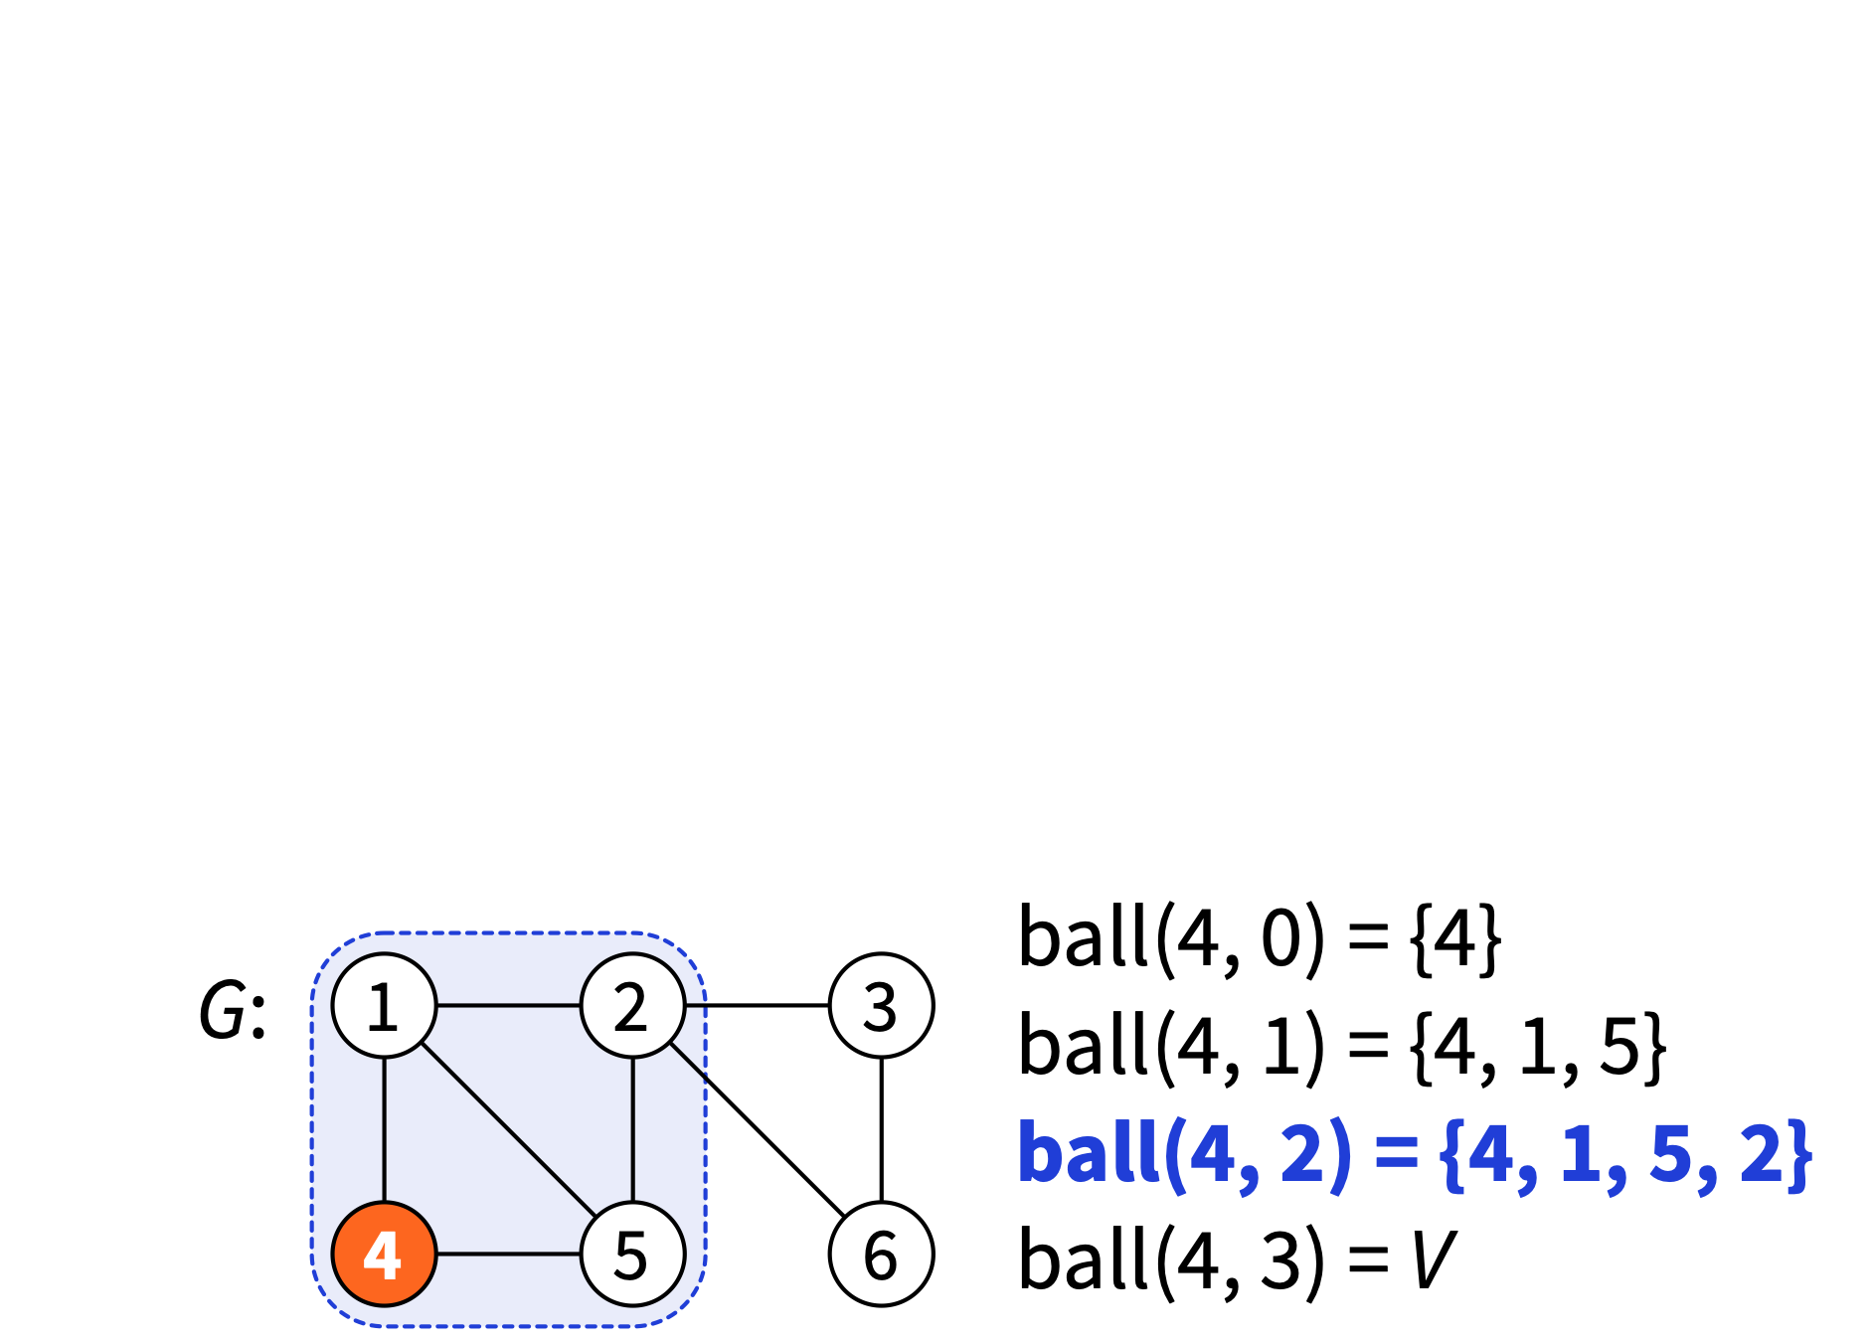
Walks, paths and connectivity
ball(v, r) = “radius-r neighbourhood of v” = nodes at distance at most r from node v

Slide 30
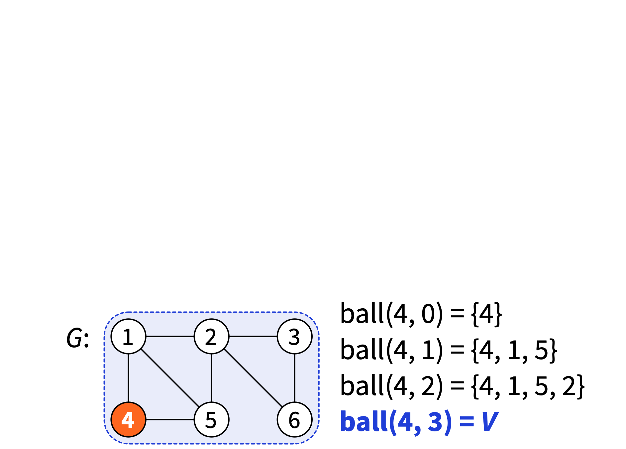
Walks, paths and connectivity
ball(v, r) = “radius-r neighbourhood of v” = nodes at distance at most r from node v

Slide 31
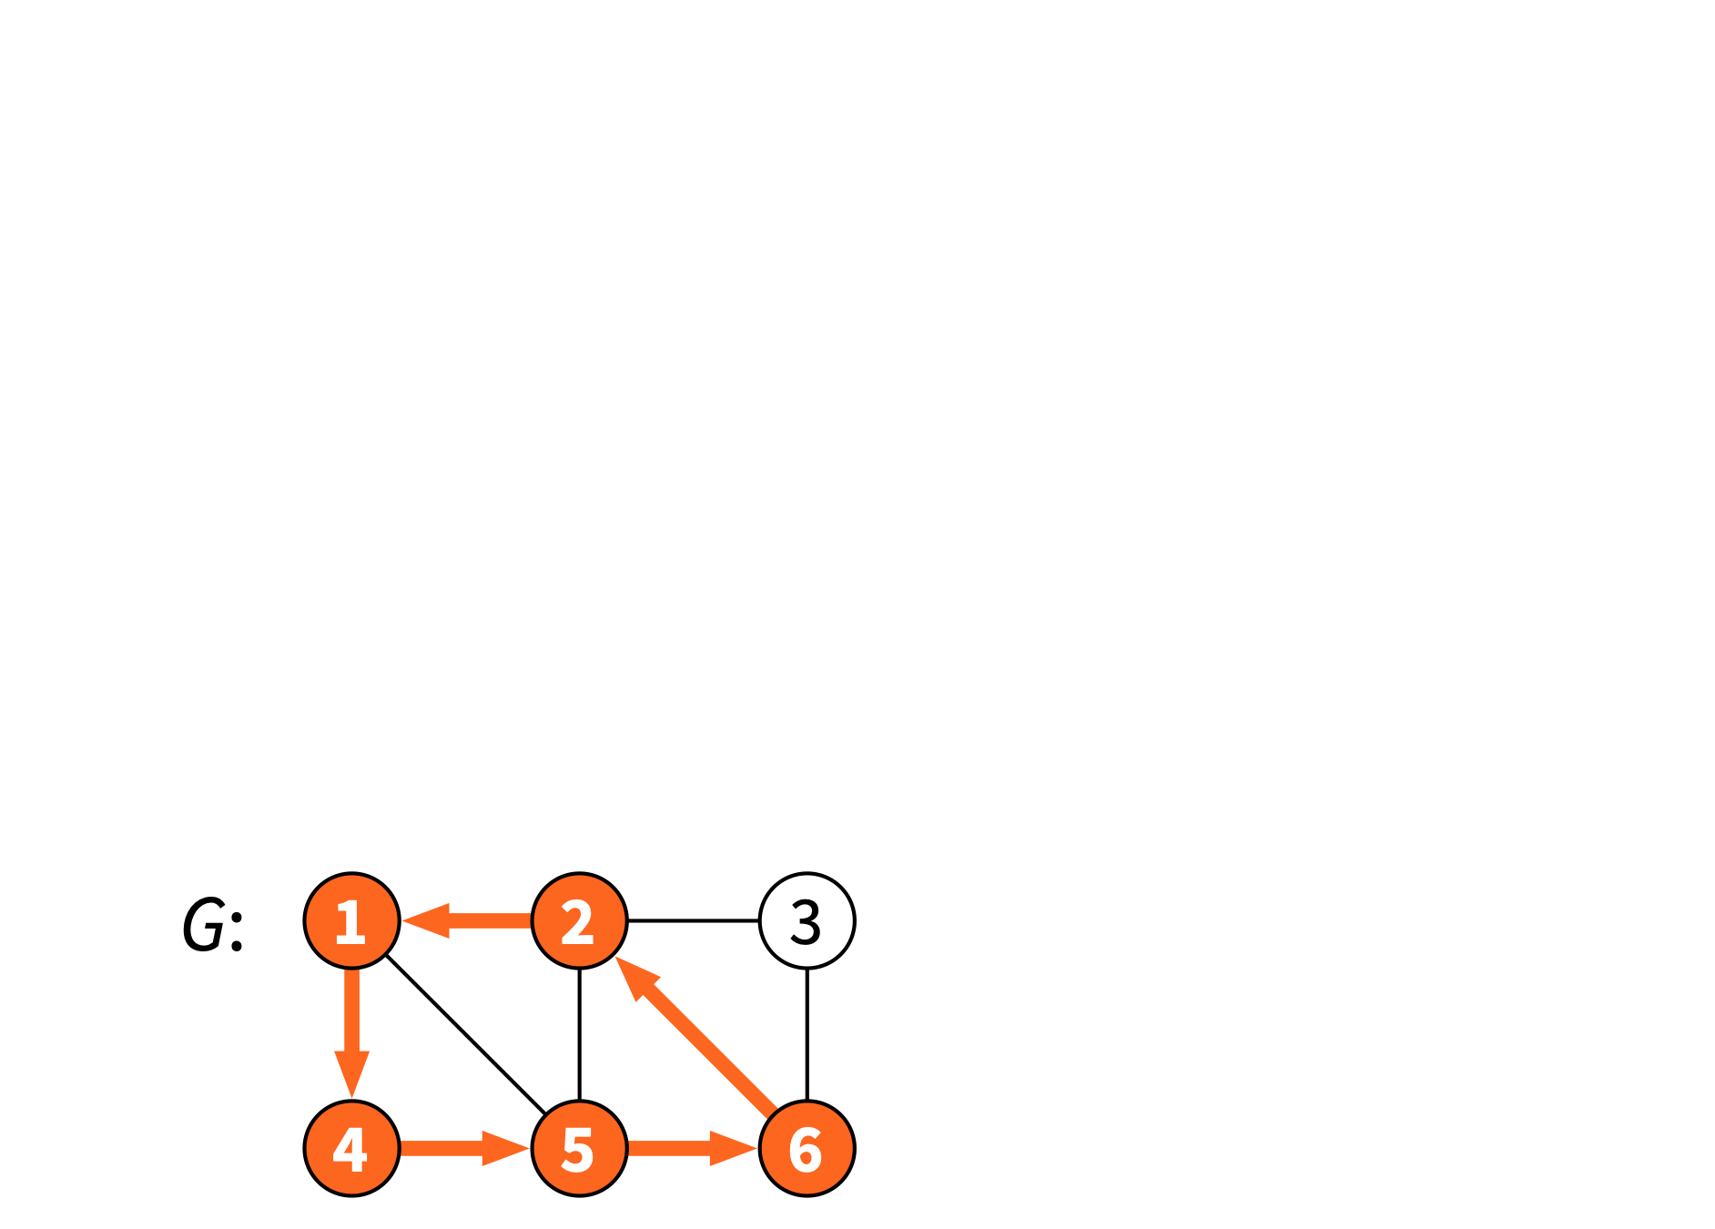
Walks, paths and connectivity
Cycle = closed walk that visits each node and each edge at most once (length ≥ 3)

Slide 32
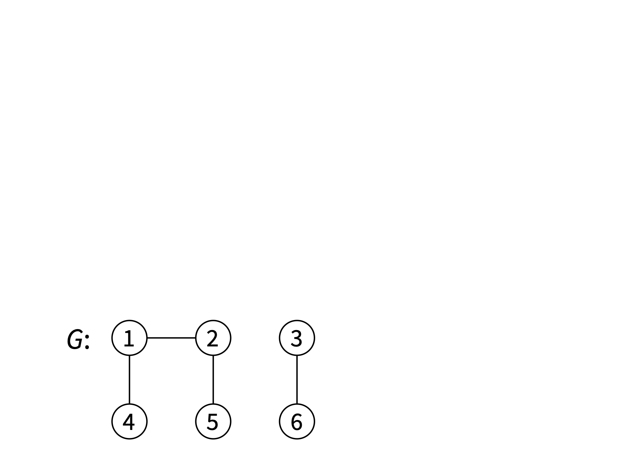
Walks, paths and connectivity
Acyclic graph = graph without any cycles

Slide 33

Walks, paths and connectivity
Tree = connected acyclic graph Forest = acyclic graph

Slide 34
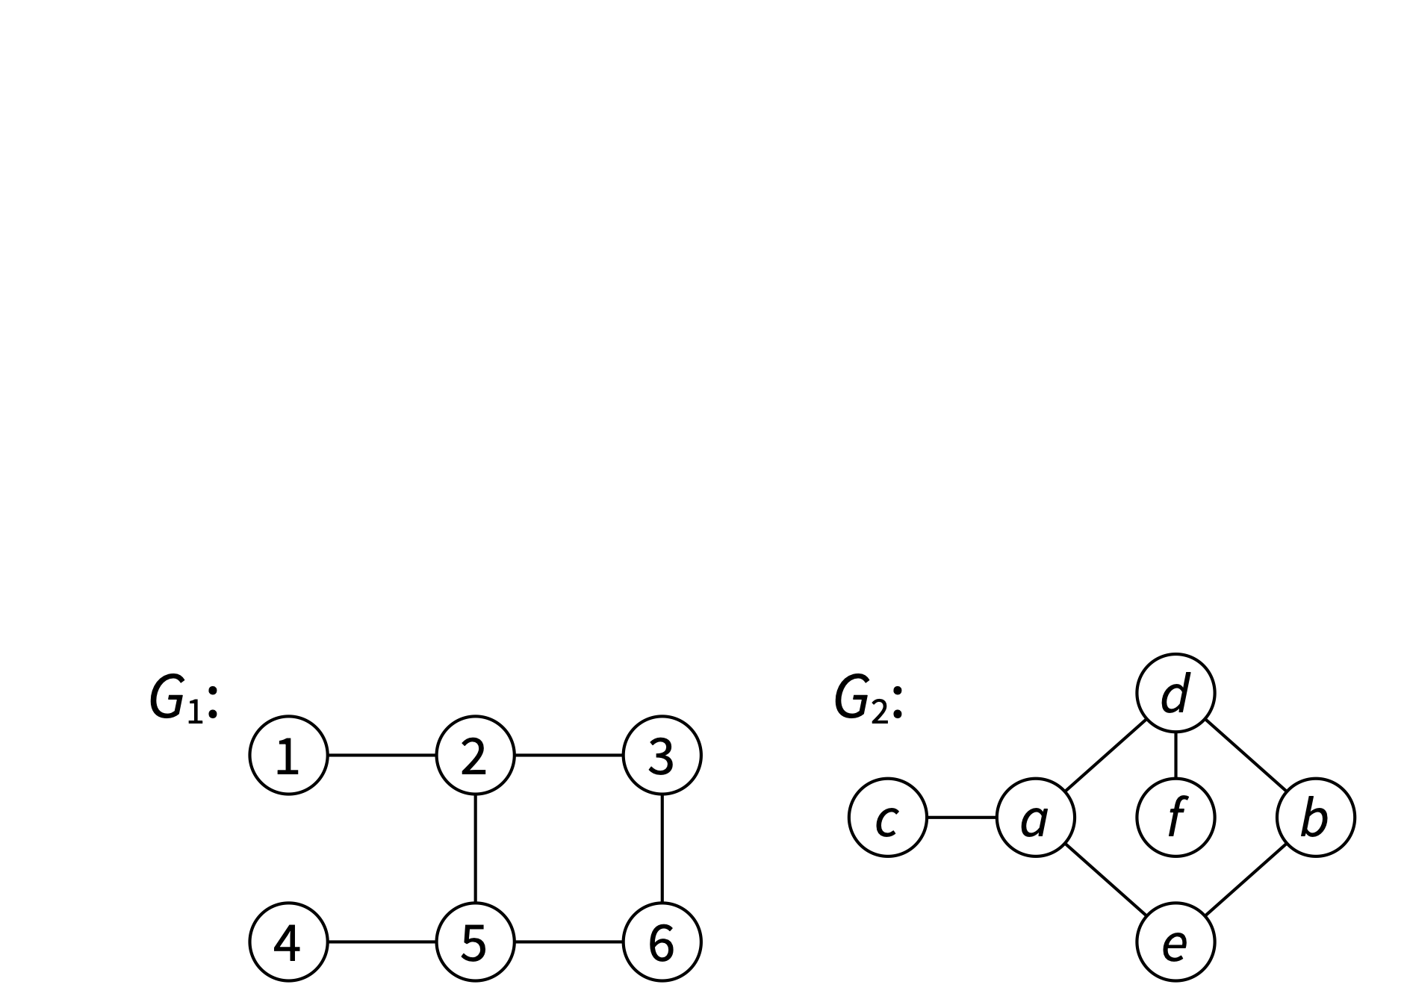
Isomorphism
Isomorphism from G₁ = (V₁, E₁) to G₂ = (V₂, E₂): bijection f: V₁ → V₂ that preserves adjacency

Slide 35
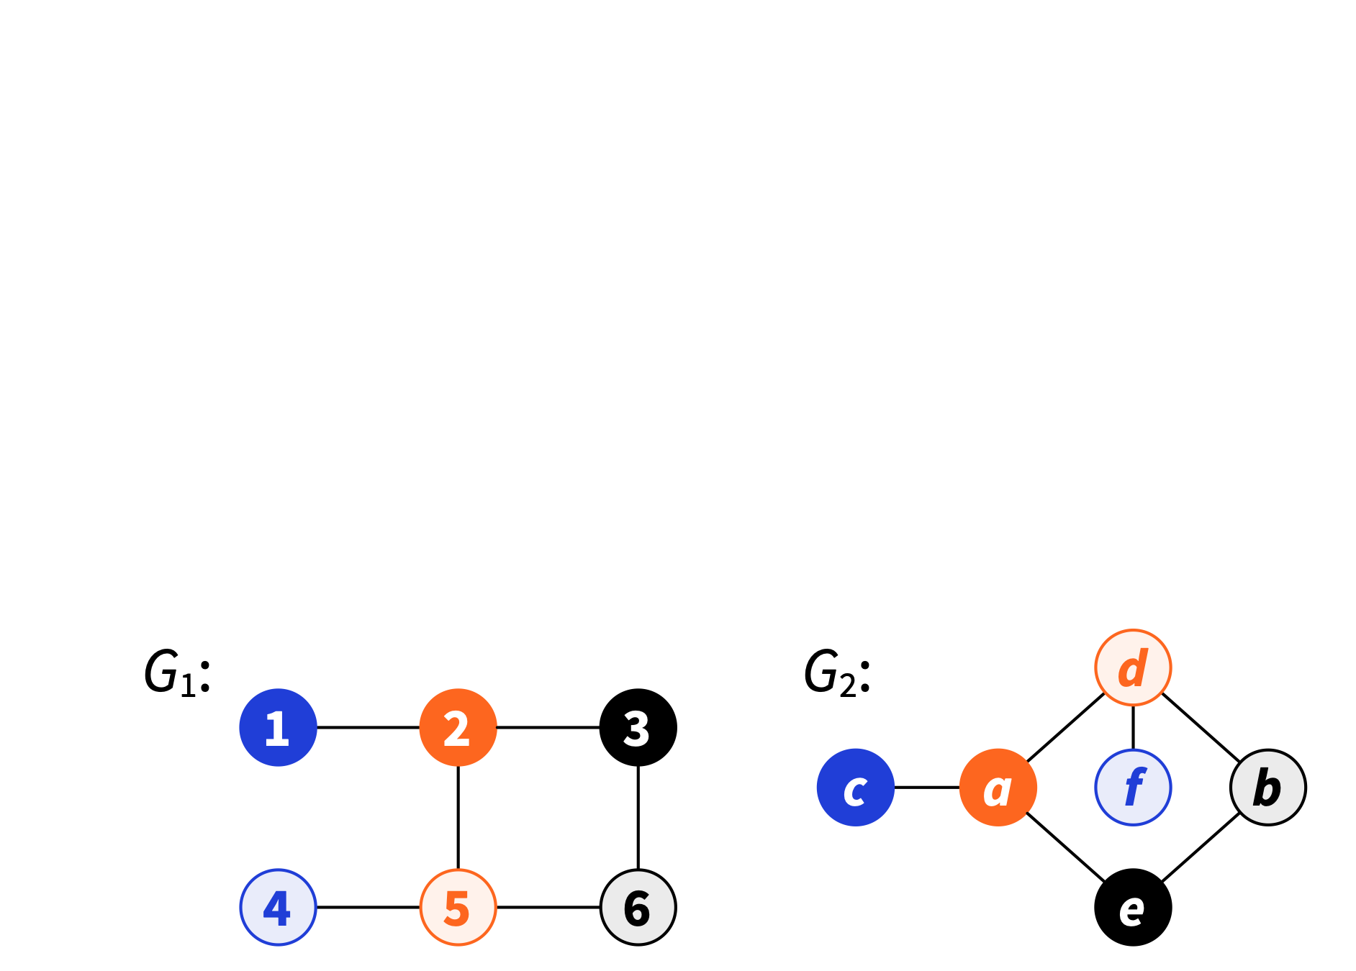
Isomorphism
Isomorphism from G₁ = (V₁, E₁) to G₂ = (V₂, E₂): bijection f: V₁ → V₂ that preserves adjacency

Slide 36
Isomorphism
Graphs are isomorphic if there exists an isomorphism from one to another

Slide 37
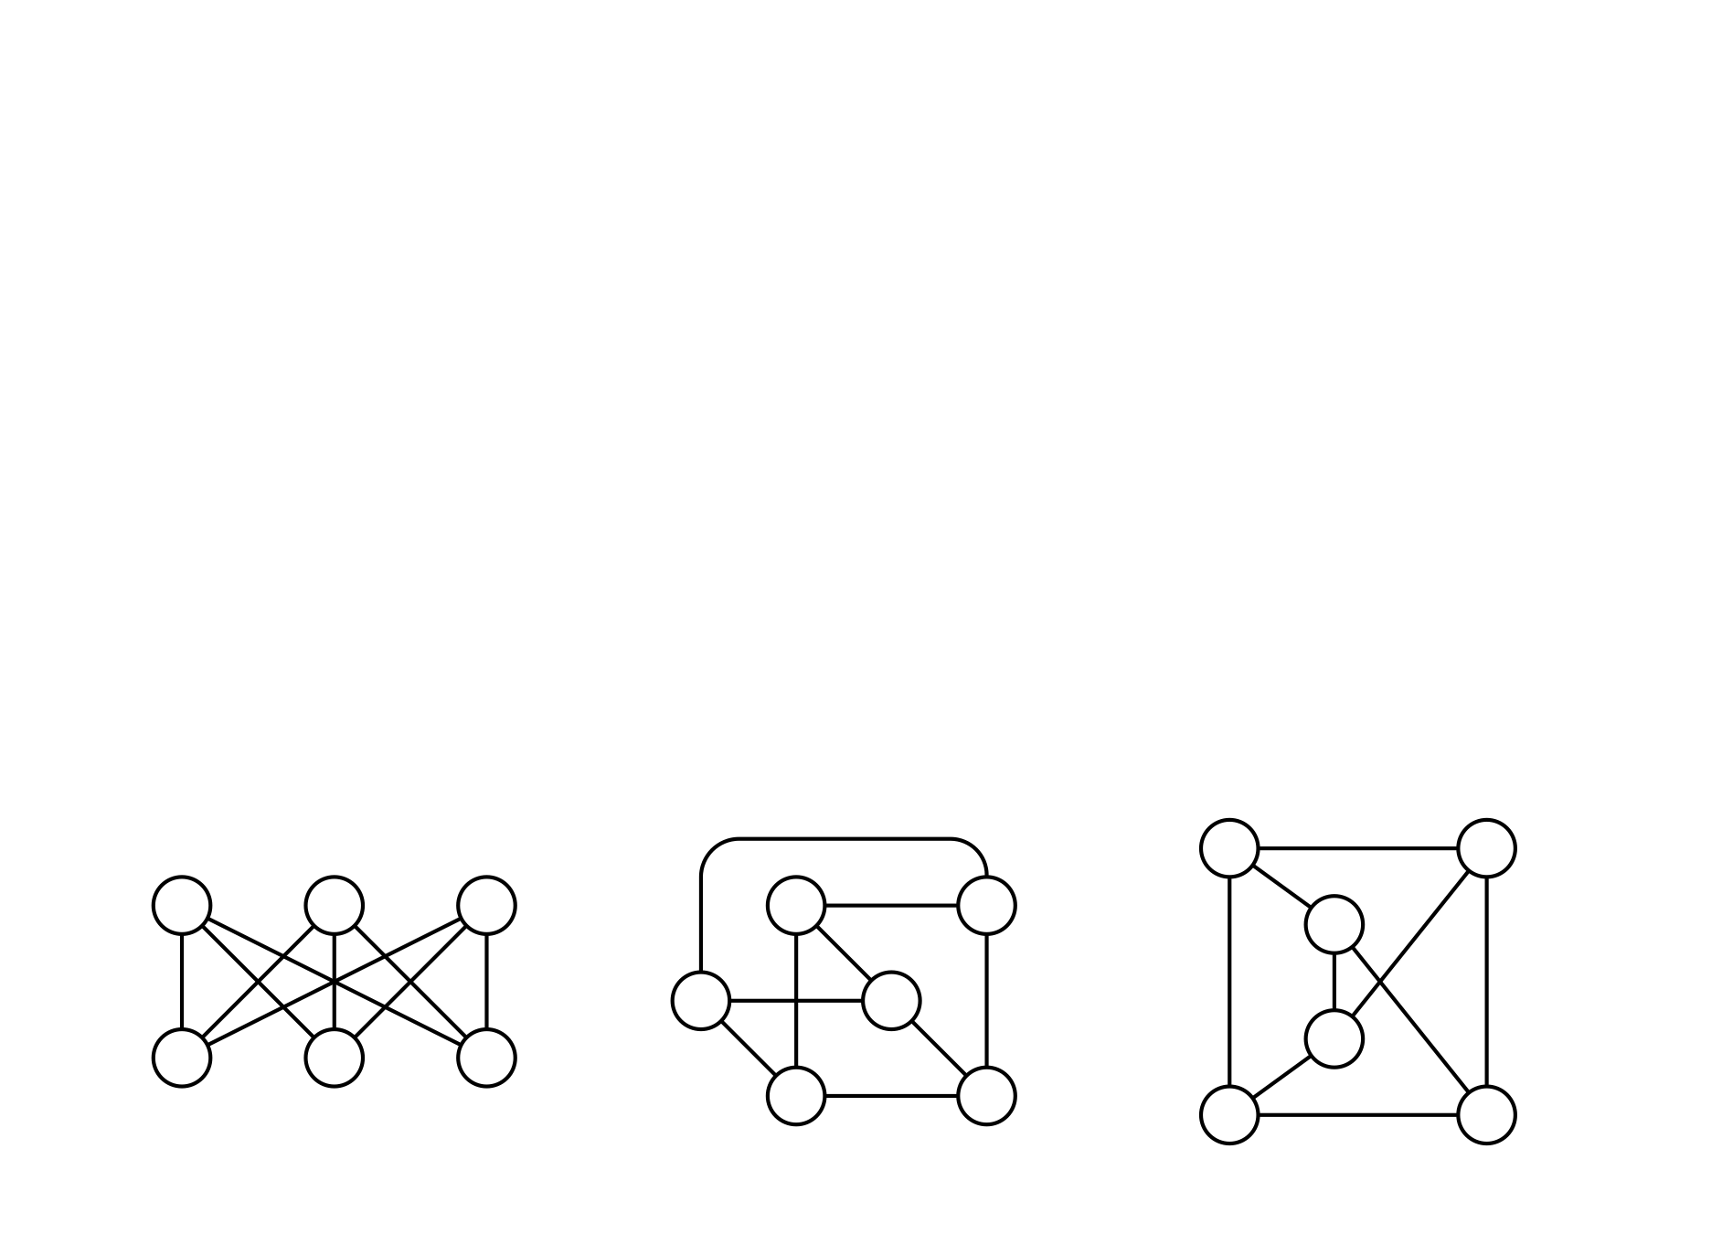
Isomorphism
Graphs are isomorphic if there exists an isomorphism from one to another

Slide 38
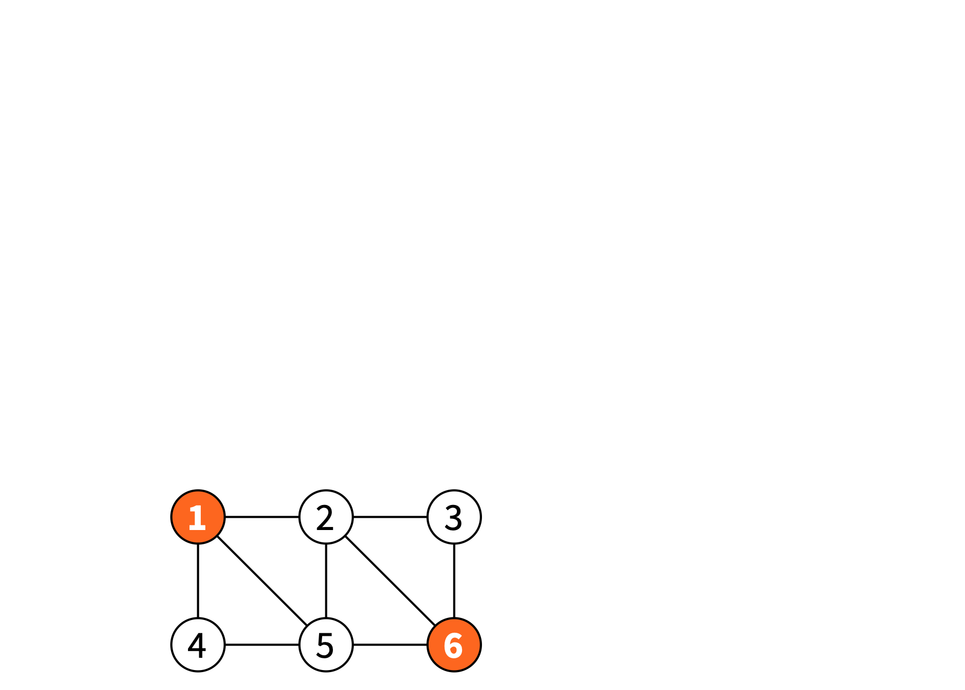
Graph problems
Independent set: non-adjacent nodes

Slide 39
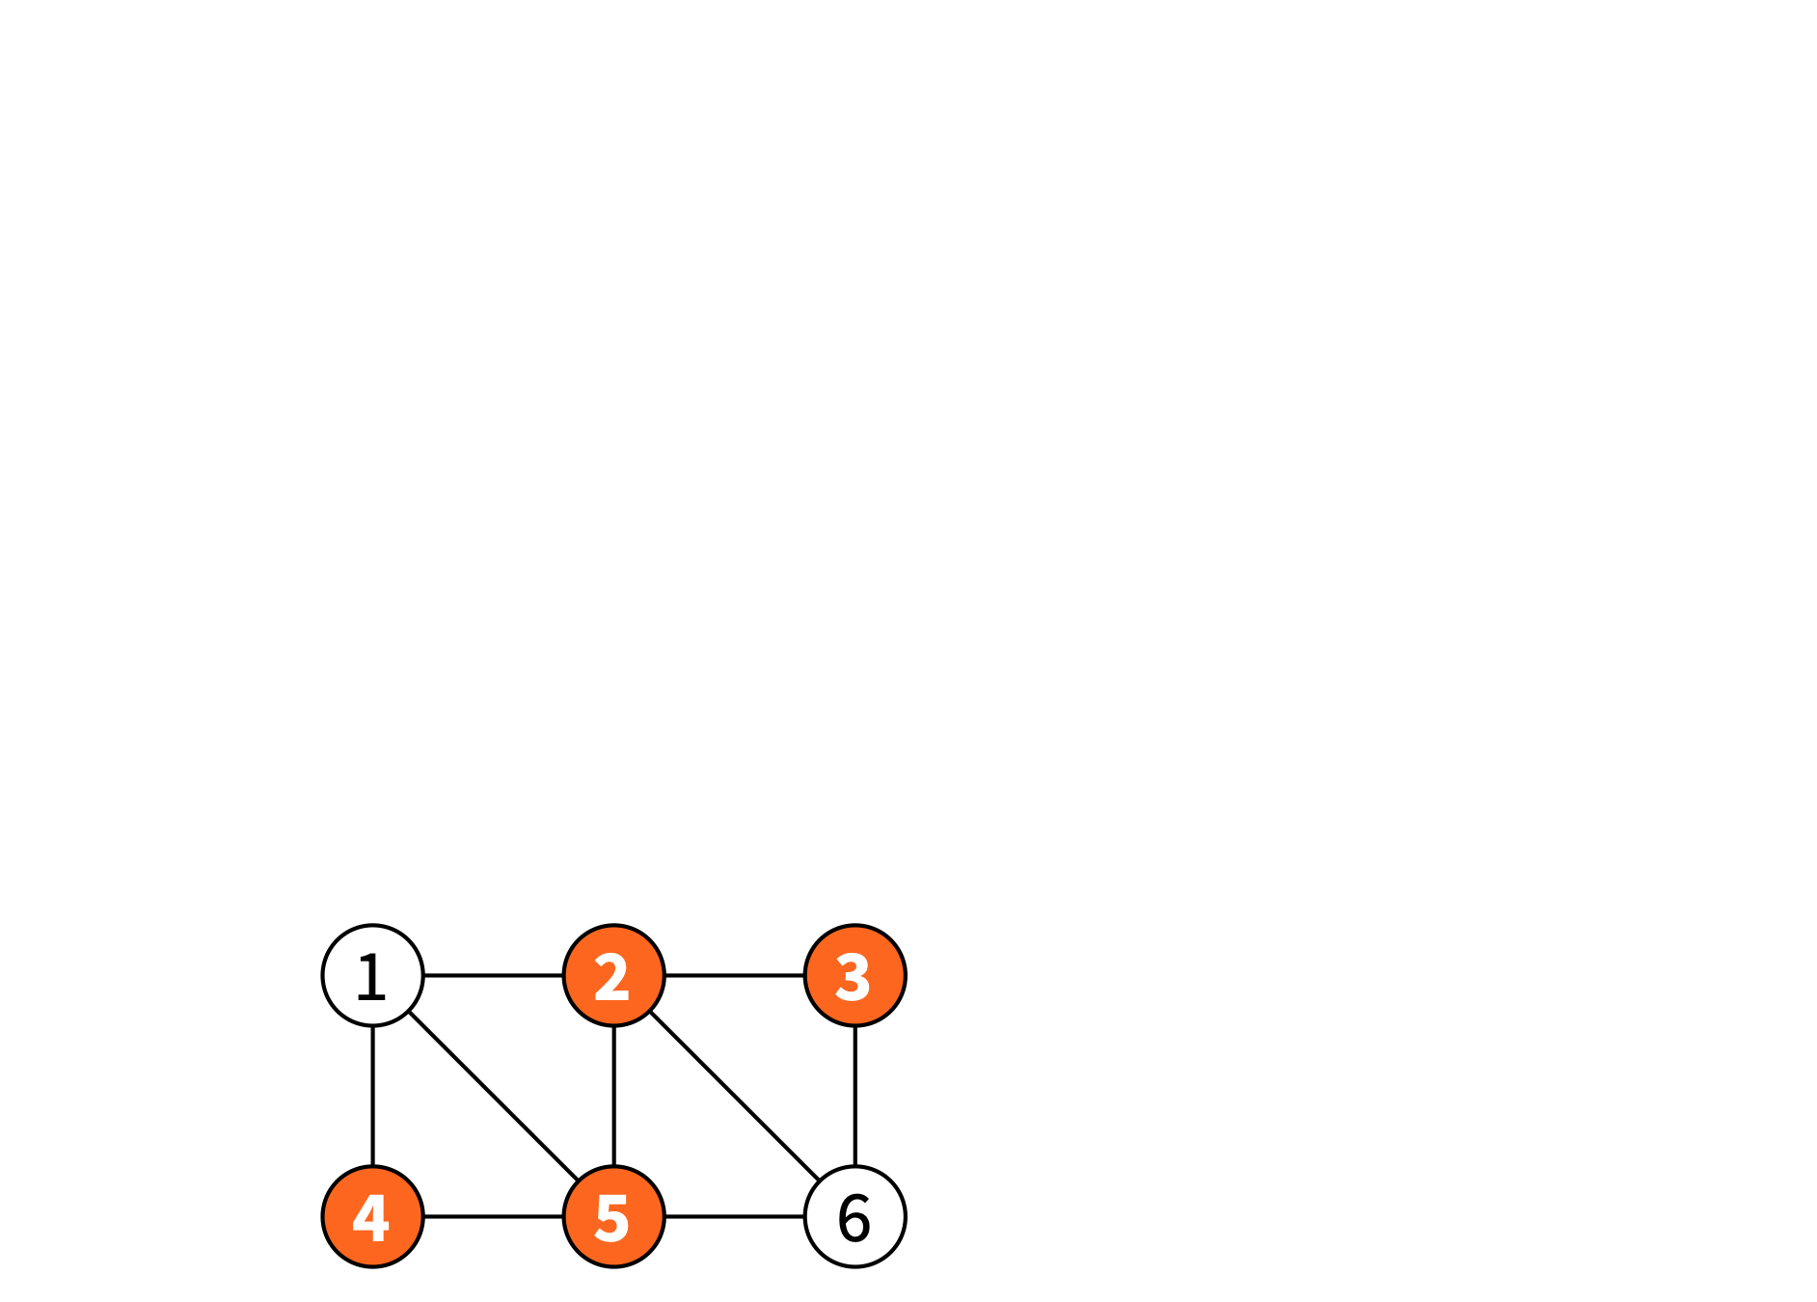
Graph problems
Vertex cover: at least one endpoint of each edge (all edges are “covered” with these nodes)

Slide 40
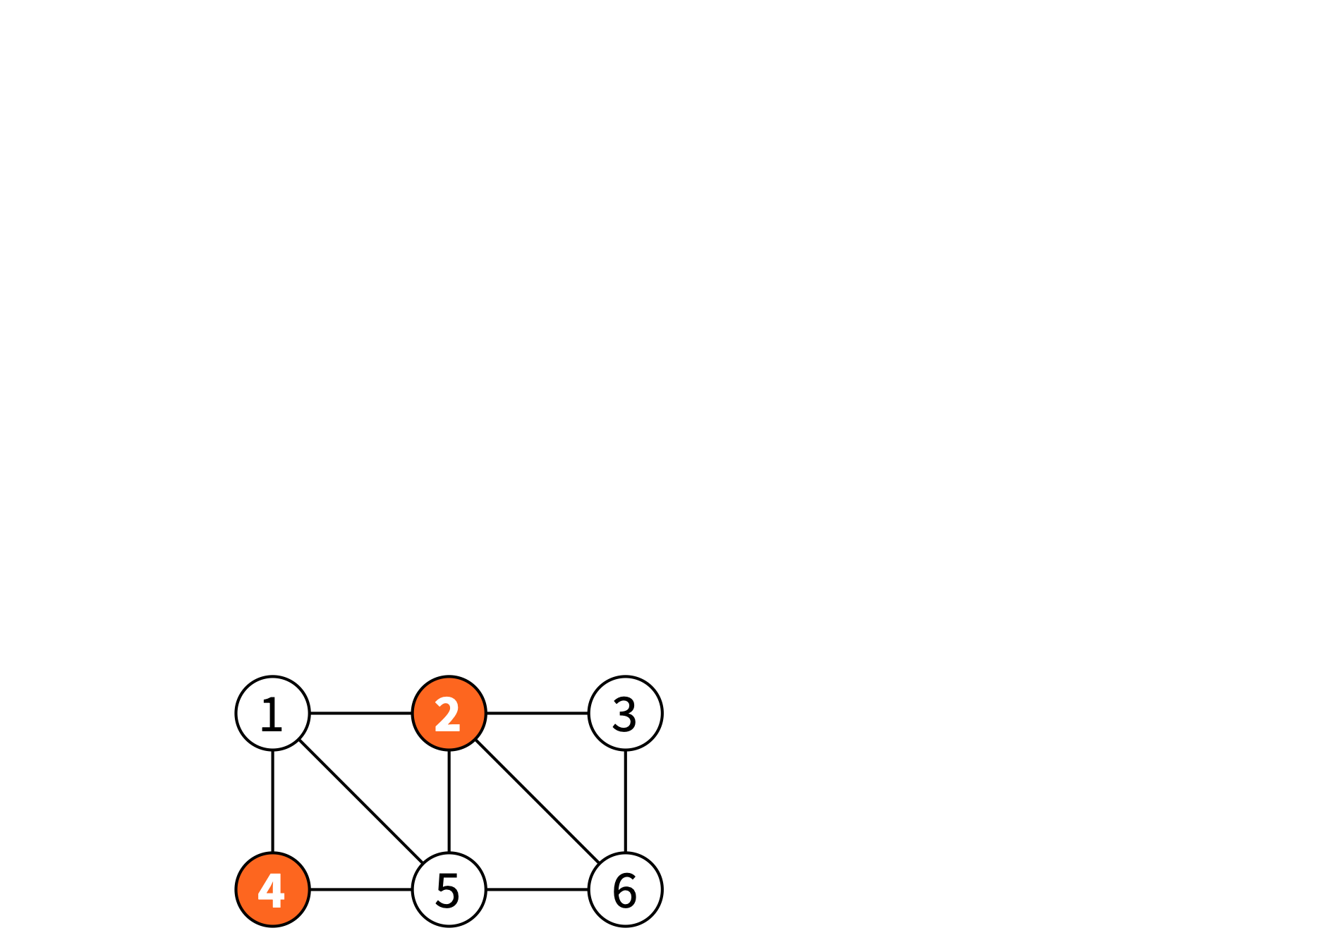
Graph problems
Dominating set: all other nodes have a neighbour in this set

Slide 41
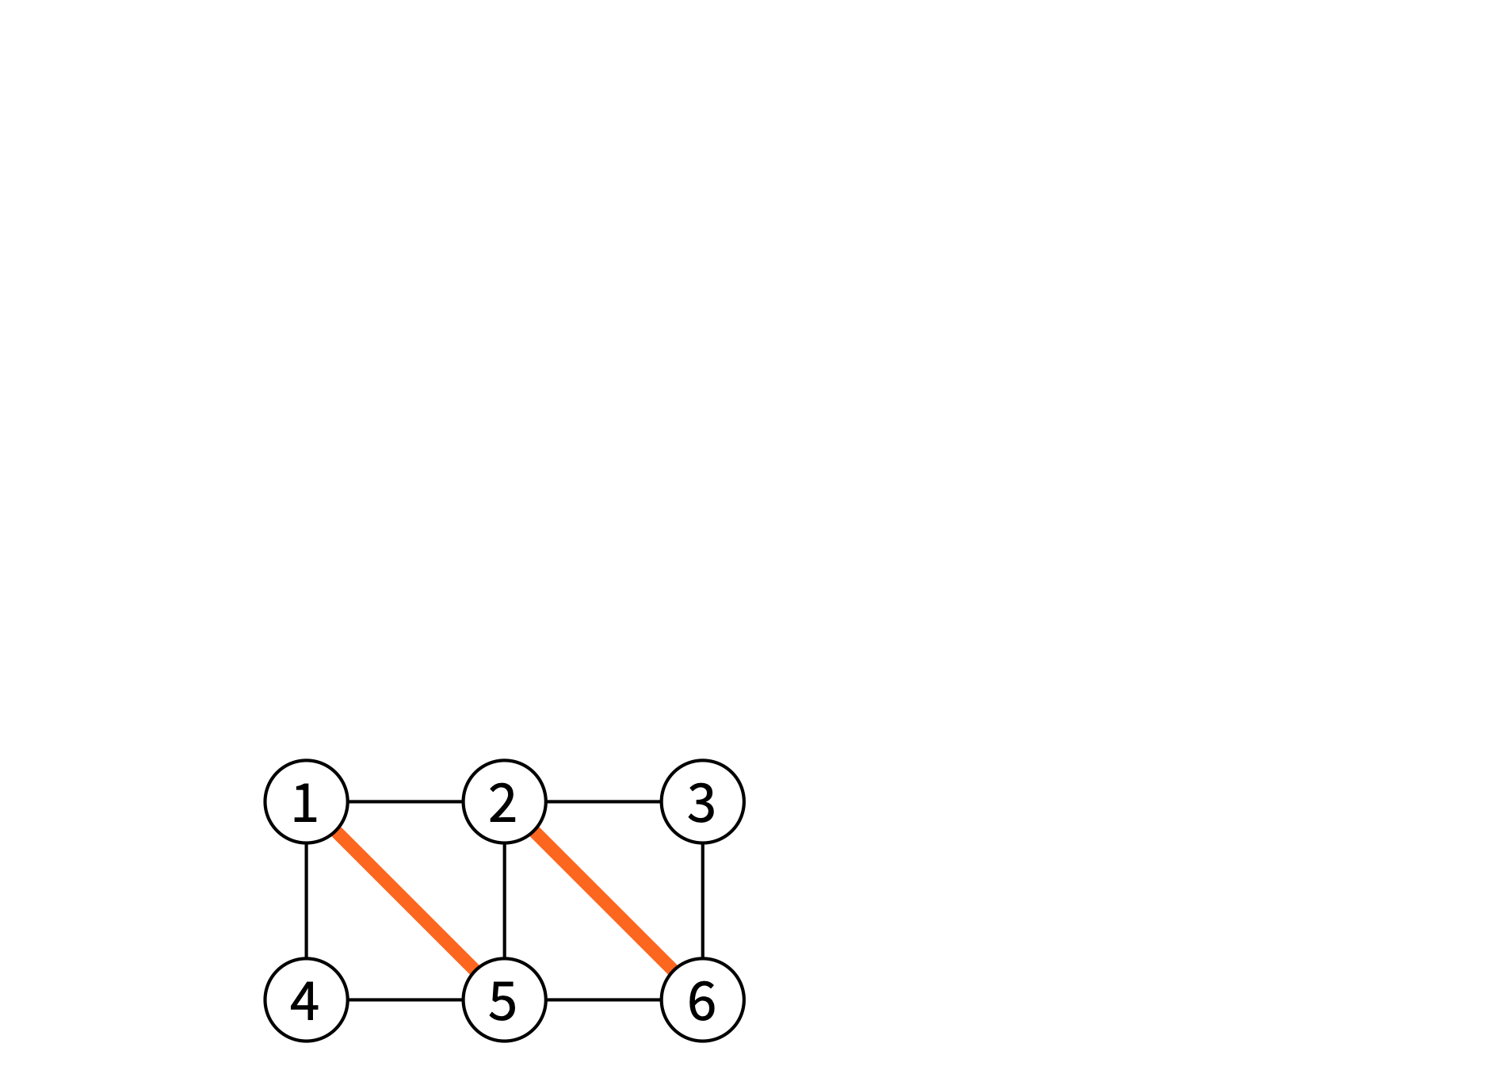
Graph problems
Matching: non-adjacent edges

Slide 42
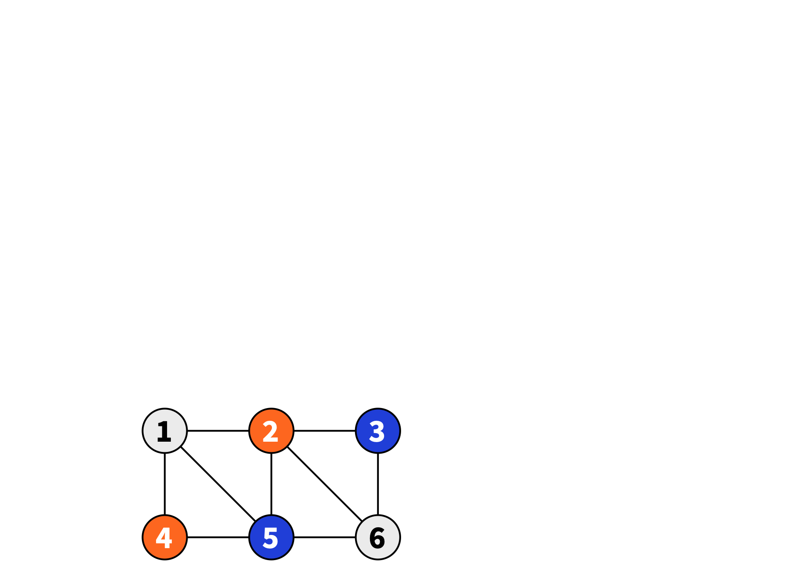
Graph problems
Vertex coloring: adjacent nodes have different colours

Slide 43
Graph problems
Vertex coloring: each colour class is an independent set

Slide 44
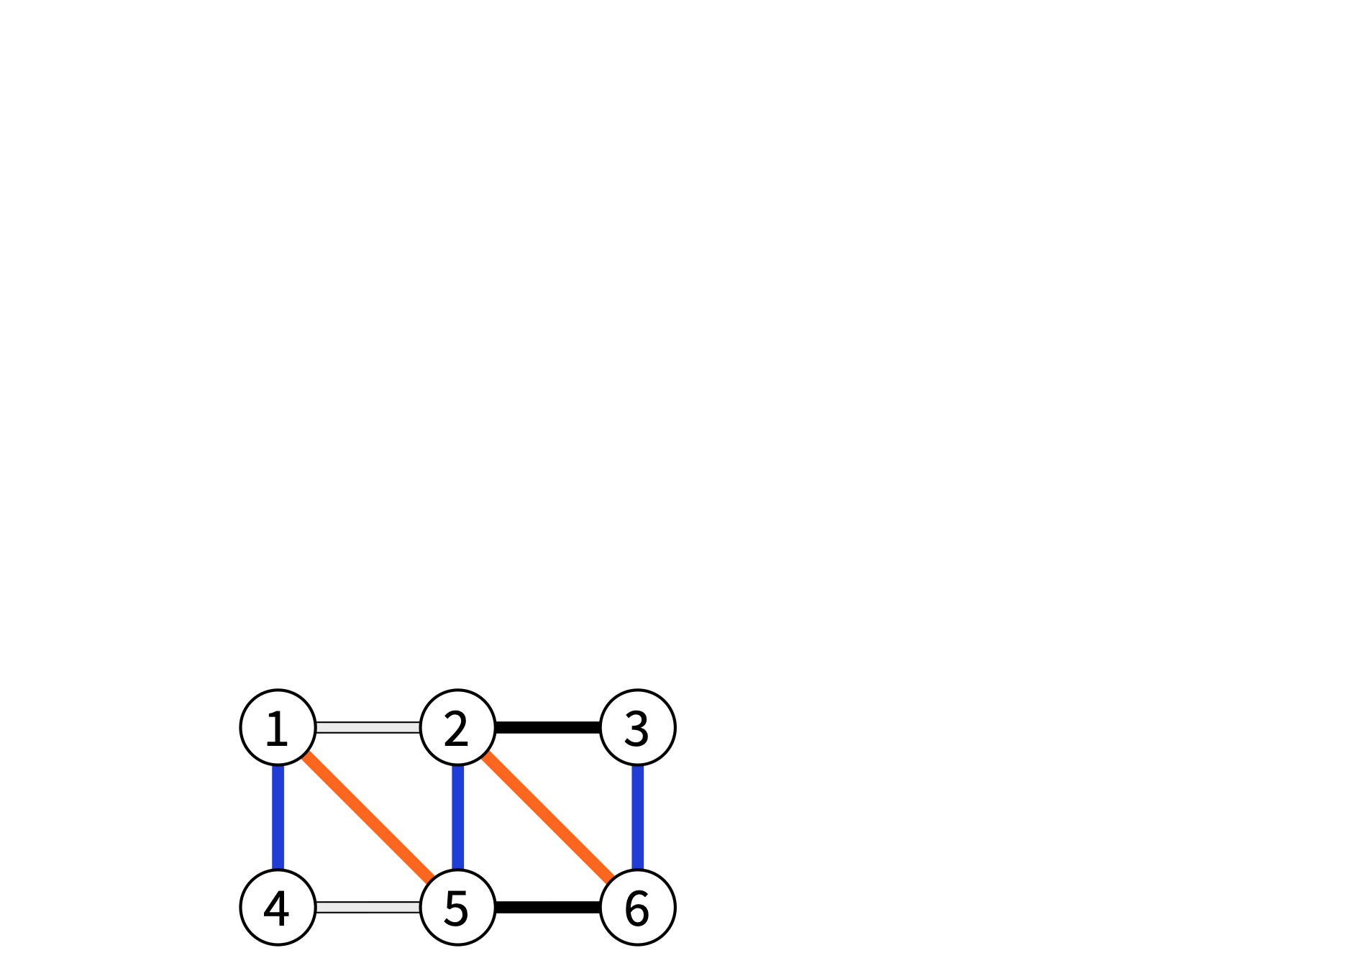
Graph problems
Edge coloring: adjacent edges have different colours

Slide 45
Graph problems
Edge coloring: each color class is a matching

Slide 46
Maximisation problems
maximal = cannot add anything
maximum = largest possible size
x-approximation = at least 1/x times maximum

Slide 47
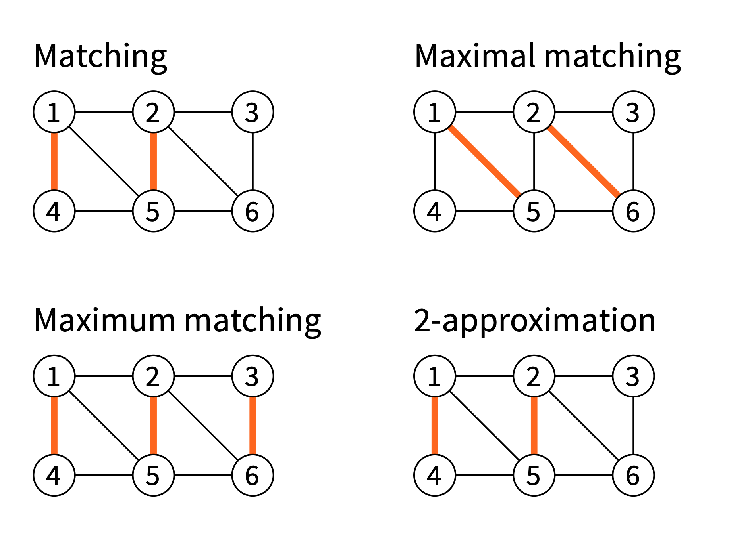
Maximisation problems

Slide 48
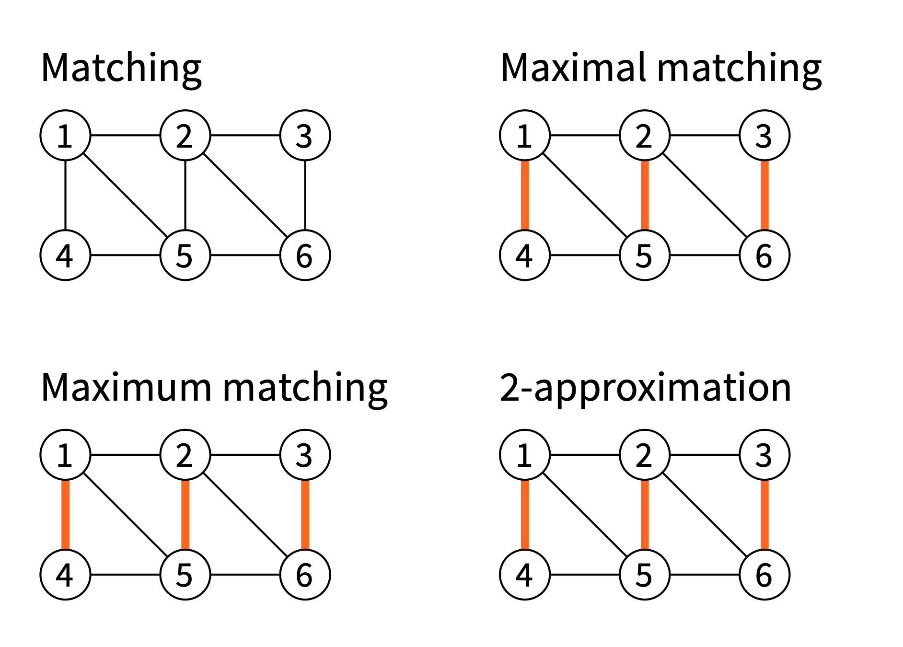
Maximisation problems

Slide 49
Minimisation problems
minimal = cannot remove anything
minimum = smallest possible size
x-approximation = at most x times minimum

Slide 50
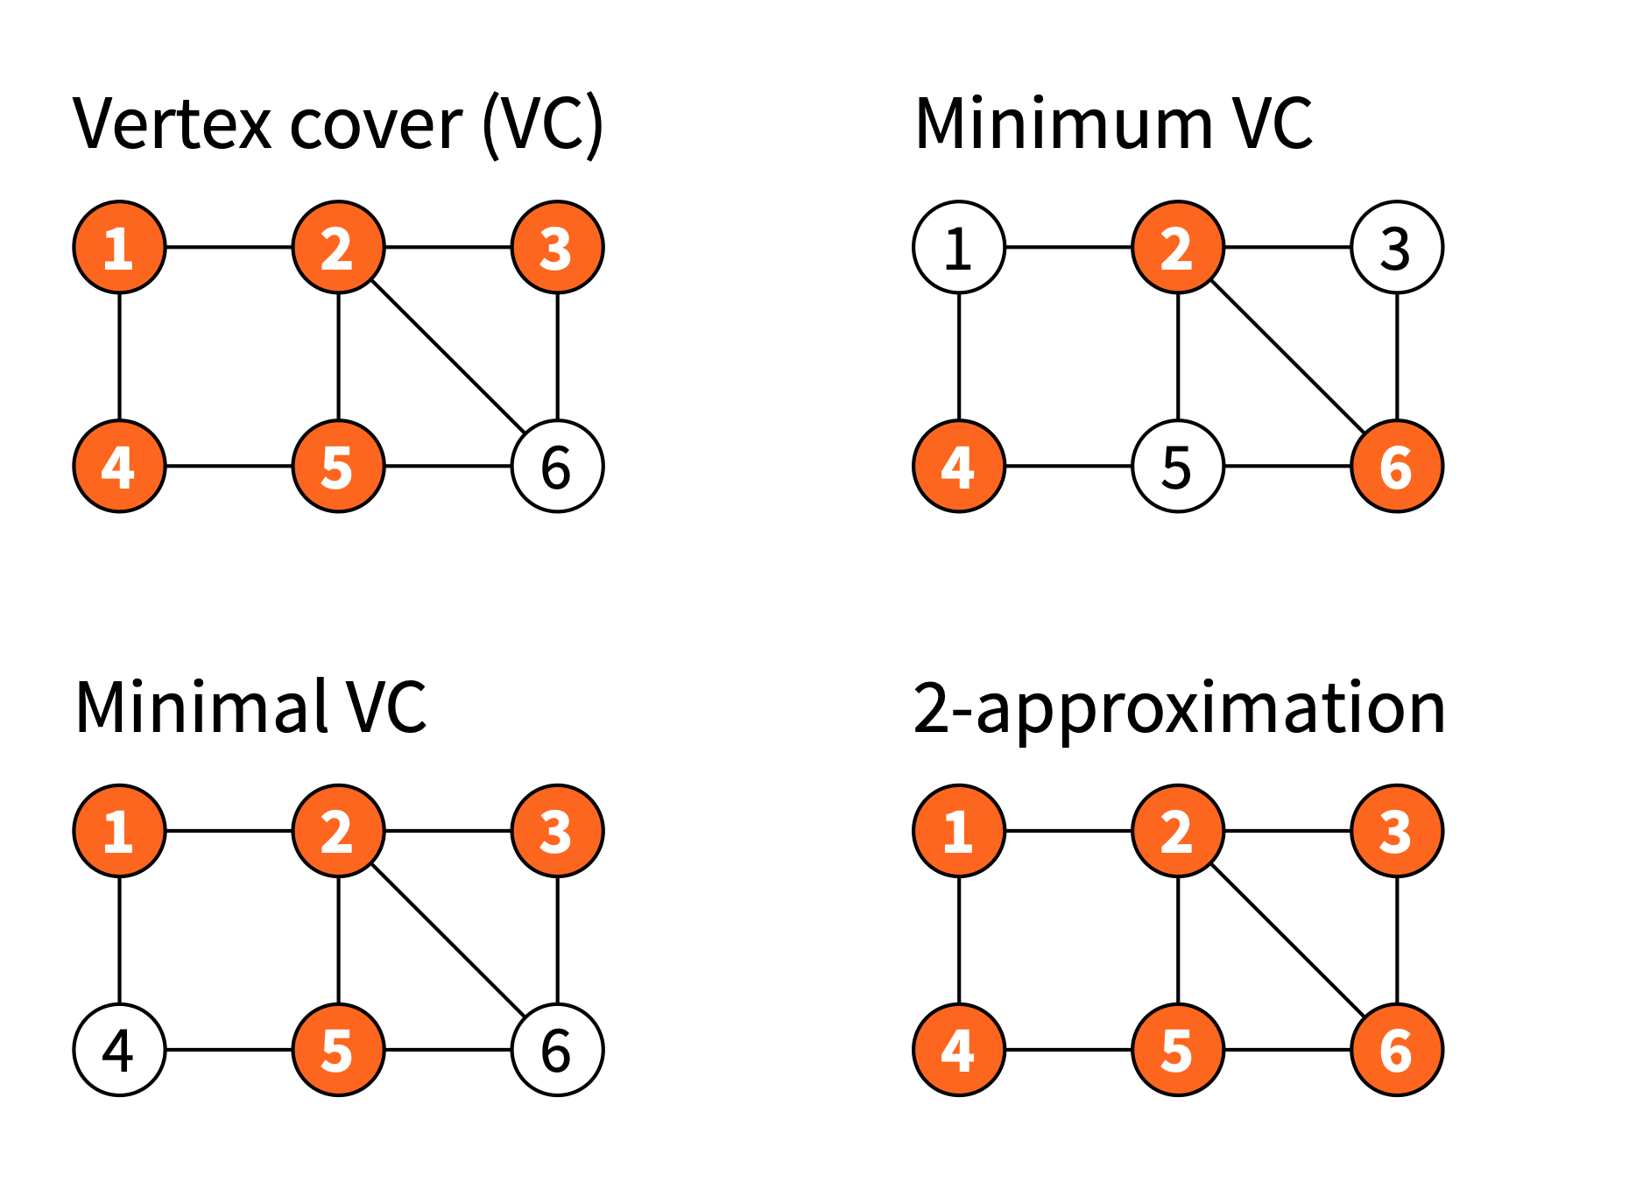
Minimisation problems

Slide 51
Approximation
Approximations are always feasible solutions!
“2-approximation of minimum vertex cover”
vertex cover
≤ 2 times as large as minimum vertex cover

Slide 52
Optimization problem
An optimization problem has the following characteristics:
A solution is a subset of one of the data in the problem;
There are in general several admissible solutions;
Each (admissible) solution has an associated value (usually a cost or a gain).
The optimization problem consists not only in finding an admissible solution, but also in finding a admissible solution, but to find a solution of minimal value or maximum value.
Example : giving change
- Problem : we have coins of values v1, v2, .., vn ;
- Solution : a sequence of (values of) coins with total S ;
- Best solution : the one using the least number of coins.

Slide 53
Greedy Algorithms
It is a particular strategy to solve an optimization problem.
A greedy algorithm is an algorithm that builds a solution :
- element by element without ever going back ;
- based on local considerations.

Slide 54
Example of greedy algorithm
Greedy algorithm
1. As long as S > 0 ;
2. Choose the piece with the largest value v less than S ;
3. Repeat with S - v.

Slide 55
Example of greedy algorithm
Greedy algorithm
1. As long as S > 0 ;
2. Choose the piece with the largest value v less than S ;
3. Repeat with S - v.
Correct example
S =16 with pieces of 10,5,2, 1:
16 - 10 = 6
6 - 5 = 1
1 - 1 = 0
3 pieces

Slide 56
Example of greedy algorithm
Greedy algorithm
1. As long as S > 0 ;
2. Choose the piece with the largest value v less than S ;
3. Repeat with S - v.
Correct example
S =16 with pieces of 10,5,2, 1:
16 - 10 = 6
6 - 5 = 1
1 - 1 = 0
3 pieces
Incorrect example
S=16 with pieces of 9,8,1:
16 - 9 = 7
7 - 1 = 6
…
8 pieces (best case is 8 + 8 = 16)

Slide 57
Coloration of a graph with a greedy algorithm
Idea of the algorithm
We have a graph G = ( V , E ). For any v ∈ V :
- We look at the set of colors already assigned to the neighbors of v.
- We deduce the smallest natural number that does not belong to this set.
- We assign this color to v.

Slide 58
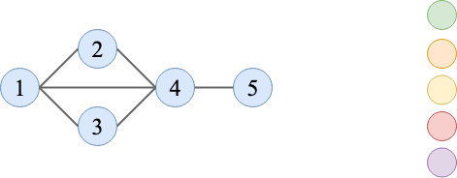
Coloration of a graph with a greedy algorithm
Idea of the algorithm
We have a graph G = ( V , E ). For any v ∈ V :
- We look at the set of colors already assigned to the neighbors of v.
- We deduce the smallest natural number that does not belong to this set.
- We assign this color to v.

Slide 59
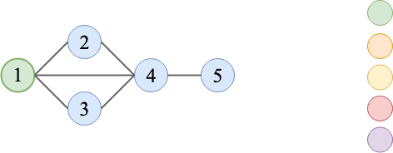
Coloration of a graph with a greedy algorithm
Idea of the algorithm
We have a graph G = ( V , E ). For any v ∈ V :
- We look at the set of colors already assigned to the neighbors of v.
- We deduce the smallest natural number that does not belong to this set.
- We assign this color to v.

Slide 60
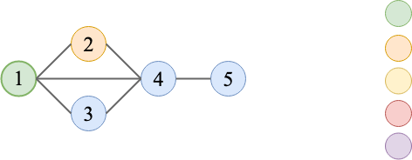
Coloration of a graph with a greedy algorithm
Idea of the algorithm
We have a graph G = ( V , E ). For any v ∈ V :
- We look at the set of colors already assigned to the neighbors of v.
- We deduce the smallest natural number that does not belong to this set.
- We assign this color to v.

Slide 61
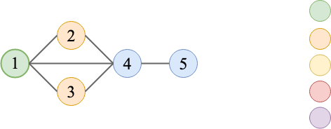
Coloration of a graph with a greedy algorithm
Idea of the algorithm
We have a graph G = ( V , E ). For any v ∈ V :
- We look at the set of colors already assigned to the neighbors of v.
- We deduce the smallest natural number that does not belong to this set.
- We assign this color to v.

Slide 62
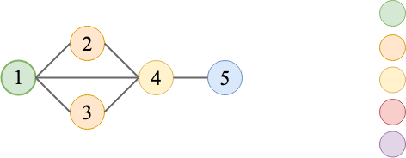
Coloration of a graph with a greedy algorithm
Idea of the algorithm
We have a graph G = ( V , E ). For any v ∈ V :
- We look at the set of colors already assigned to the neighbors of v.
- We deduce the smallest natural number that does not belong to this set.
- We assign this color to v.

Slide 63
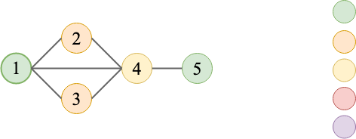
Coloration of a graph with a greedy algorithm
Idea of the algorithm
We have a graph G = ( V , E ). For any v ∈ V :
- We look at the set of colors already assigned to the neighbors of v.
- We deduce the smallest natural number that does not belong to this set.
- We assign this color to v.

Slide 64
Reminders about tree
a tree is a connected graph without cycle.
Be careful, the notion is different from the trees usually used in algo:
- No arity constraint ;
- No notion of root
Properties
- Between two given vertices of a tree, there is always exactly an (elementary) chain;
- A tree with n vertices has n - 1 edges.

Slide 65
Spanning Tree
A subgraph of G is said to be covering if it contains all vertices of G.
Be careful, a covering subgraph is not necessarily connected.

Slide 66
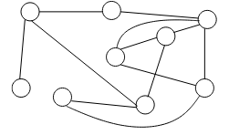
Spanning Tree
A subgraph of G is said to be covering if it contains all vertices of G.
Be careful, a covering subgraph is not necessarily connected.

Slide 67
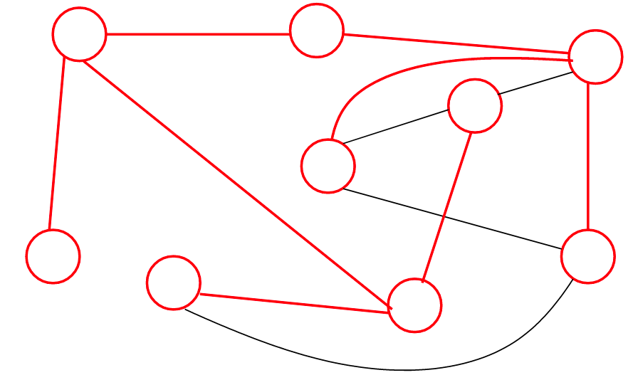
Spanning Tree
A subgraph of G is said to be covering if it contains all vertices of G.
Be careful, a covering subgraph is not necessarily connected.

Slide 68
Spanning Tree
If A is a spanning subgraph of a graph G with V vertices the following characterizations are equivalent:
- A is a spanning tree of G ;
- A is cycle-free and has V - 1 edges;
- A is connected
- We cannot add an edge to A without creating a cycle;
- We cannot remove an edge from A without breaking its connectedness

Slide 69
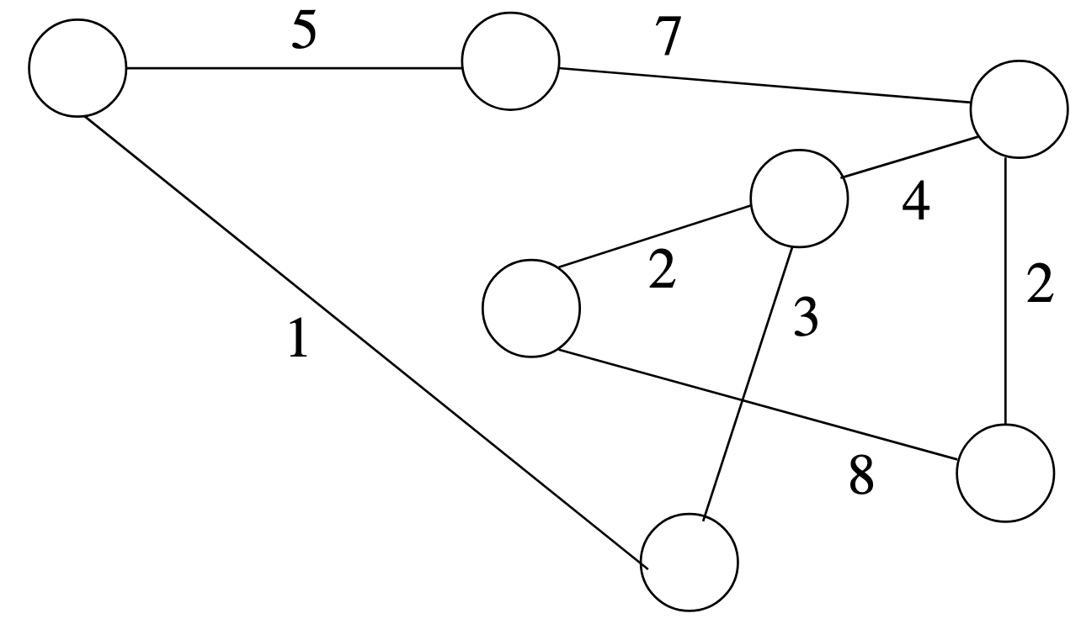
Spanning Tree in a weighted graph
Minimum weight spanning tree
The weight of a subgraph is the sum of the weights of the edges. We are looking for a minimal weight spanning tree (MST).

Slide 70
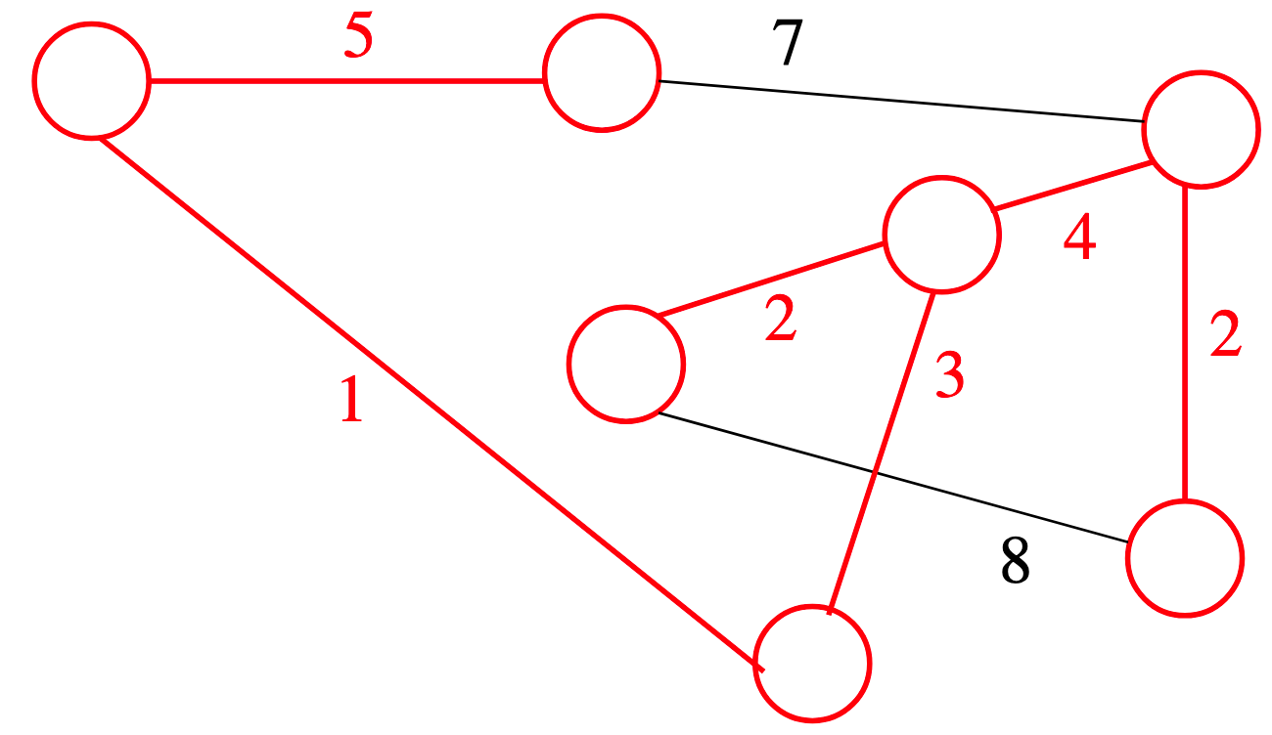
Spanning Tree in a weighted graph
Minimum weight spanning tree
The weight of a subgraph is the sum of the weights of the edges. We are looking for a minimal weight spanning tree (MST).

Slide 71
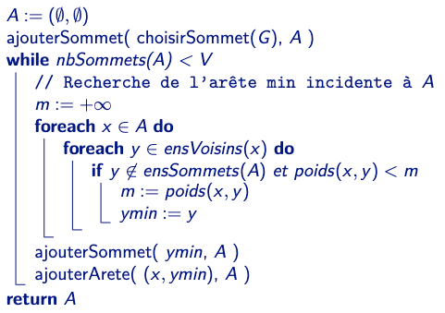
Prim’s Algorithm

Slide 72
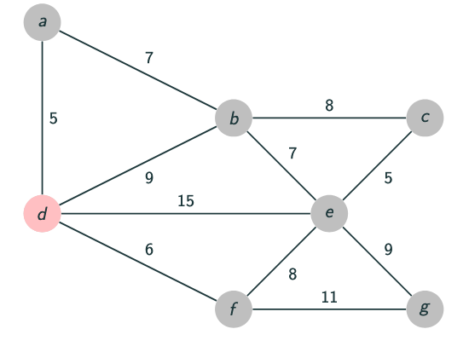
Prim’s Algorithm on an example

Slide 73

Prim’s Algorithm on an example

Slide 74

Prim’s Algorithm on an example

Slide 75

Prim’s Algorithm on an example

Slide 76

Prim’s Algorithm on an example

Slide 77

Prim’s Algorithm on an example

Slide 78

Prim’s Algorithm on an example

Slide 79
Is it a greedy algorithm ?
We find the characteristics of a greedy algorithm:
The constructed solution is a set (of edges) ;
The admissible solutions are covering trees;
We are looking for a solution of minimal total weight;
Prim's algorithm proceeds only by adding edges (and vertices) in A;
he choice of the next edge is based only on its weight.
The algorithm therefore has a cost in O(V × C )where C is the cost of choosing the next edge;

Slide 80
Graph theory and
distributed algorithms
Network ≈ graph: node ≈ computer, edge ≈ link
Graph theory used to:
define: model of computing, what we want to solve, what we assume …
prove: correctness of algorithms, time complexity, impossibility results …

Slide 81
Distributed Algorithm : Message Passing Model
Notes:
‹#›

Slide 82
Message-Passing Model
‹#›
In a message-passing system, processors communicate by sending messages over communication channels, where each channel provides a bidirectional connection between two specific processors.
The pattern of connections provided by the channels describes the topology of the system.
The topology is represented by an undirected graph in which
each node represents a processor and
an edge exists between two nodes if and only if there is a communication channel between the corresponding processors.
Notes:
‹#›

Slide 83
Message-Passing Model
‹#›
processors are p₀, p₁, …, p_{n-1} (nodes of graph)
each processor p_{i} labels its incident channels with the integers 1, 2, …r where r is the degree of p_{i}
1, 2, 3 for p₀ in the exemple
1
1
p₃
p₀
2
3
2
2
p₂
p₁
1
1
Notes:
‹#›

Slide 84
Modeling Processors and Channels
‹#›
Processor is a state machine including
local state of the processor
mechanisms for modeling channels
Channel directed from processor p_{i} to processor p_{j} is modeled in two pieces:
outbuf variable of p_{i} : msgs p_{i} has sent to p_{j} and not yet delivered to p_{j}
inbuf variable of p_{j} : msgs delivered by p_{j} and not yet processed by p_{j}
Outbuf corresponds to physical channel, inbuf to incoming message queue
Notes:
‹#›

Slide 85
Modeling Processors and Channels
‹#›
inbuf[1]
outbuf[2]
p₁'s local
variables
p₂'s local
variables
outbuf[1]
inbuf[2]
Pink area (local vars + inbuf) is accessible state
for a processor.
Notes:
‹#›

Slide 86
Processor state and configuration
‹#›
The state of a processor p_{i} contains 2r components where r is the number of neighbors of p_{i} . In particular for every neighbor j
outbuf[j] : is the set of msgs p_{i} has sent to p_{j} and not yet delivered to p_{j}
inbuf[j] variable of p_{j} : msgs from p_{j} delivered by p_{i} and not yet processed by p_{i}
A configuration is a vector C=(q₀,q₁,…,q_{n-1}) where q_{i} is a state of process p_{i}
An initial configuration is a vector (q₀,q₁,…,q_{n-1}) such that q_{i} is the initial state of process p_{i}
Notes:
‹#›

Slide 87
A Deliver Event
‹#›
Moves a message from sender's outbuf to receiver's inbuf; message will be available next time receiver takes a step
p₁
m₃ m₂ m₁
p₂
p₁
m₃ m₂ m₁
p₂
Notes:
‹#›

Slide 88
A Computation Event
‹#›
Occurs at one processor and represents a computation step where the process applies its transition function :
Start with old accessible state (local vars + incoming messages)
Apply transition function of processor's state machine; handles all incoming messages
End with new accessible state with empty inbufs, and new outgoing messages
Notes:
‹#›

Slide 89
Execution
‹#›
The behavior of the system over time is modeled as an execution : a sequence of configurations alternating with events :
config, event, config, event, config, …
in first config: each processor is in initial state and all inbufs are empty
for each consecutive (config, event, config), new config is same as old config except:
if delivery event: specified msg is transferred from sender's outbuf to receiver's inbuf
if computation event: specified processor's state (including outbufs) change according to transition function
Notes:
‹#›
The deliver event affects the state of the sending and of the receiving process

Slide 90
Asynchronous Systems
‹#›
A system is said to be asynchronous if there is no fixed upper bound on how it takes for a message to be delivered or how much time elapses between two consecutive steps of a processor (ex. Internet)
Observation : there are usually upper bounds on message delays and processors step times, but sometimes they are very large, infrequently reached and they can vary over time :
☞ It is often desirable to write an algorithm independent of any timing parameters
Notes:
‹#›

Slide 91
Asynchronous Executions
‹#›
An execution is admissible for the asynchronous model if:
every message in an outbuf is eventually delivered
every processor takes an infinite number of steps
No constraints on when these events take place: arbitrary message delays and relative processor speeds are not ruled out
Models reliable system (no message is lost and no processor stops working)
Notes:
‹#›

Slide 92
Synchronous Message Passing Systems
‹#›
An execution is admissible for the synchronous model if it is an infinite sequence of "rounds"
A"round” is a sequence of deliver events that move all messages in transit into inbuf's, followed by a sequence of computation events, one for each processor
Notes:
‹#›
The sequence of alternating configurations and events can be partitioned into disjoint rounds

Slide 93
Synchronous Message Passing Systems
‹#›
The new definition of admissible captures lockstep unison feature of synchronous model.
This definition also implies
every message sent is delivered
every processor takes an infinite number of steps.
Time is measured as number of rounds until termination.
Notes:
‹#›

Slide 94
Message Complexity Measure
‹#›
Message complexity: maximum number of messages sent in any admissible execution
This is a worst-case measure
Notes:
‹#›

Slide 95
Distributed Algorithm : Locality
Notes:
‹#›

Slide 96
Locality
Output of a node can only depend on what it knows
After T time steps, a node can only know about things up to distance T

Slide 97

Locality
Who knows that node 15 exists?
initially, only node 15
everyone else has to learn it by exchanging messages

Slide 98

Locality
Who knows about node 15 at time T = 0?
initial state, before we exchange any messages

Slide 99

Locality
Who knows about node 15 at time T = 1?
after 1 communication round

Slide 100

Locality
Who knows about node 15 at time T = 2?
after 2 communication rounds

Slide 101

Locality
Who knows about node 15 at time T = 3?
after 3 communication rounds

Slide 102

Locality
After T communication rounds, only nodes up to distance T from node x can know anything about node x
distance = “number of hops”

Slide 103
Locality
After T communication rounds, node x can only know about other nodes that are within distance T from it
distance = “number of hops”

Slide 104
Locality
My state at time T only depends on:
my state at time T − 1, and
messages that I received on round T, which only depend on:
the state of my neighbours at time T − 1

Slide 105

Locality
State at time T only depends on initial information within distance T

Slide 106
Locality
Time = distance
Fast algorithm = “local” algorithm
outputs only depend on local neighbourhoods

Slide 107

Using locality to prove lower bounds
Example: 2-colouring of a path
Upper bound: possible in time O(n)
Lower bound: not possible in time o(n)

Slide 108
Algorithm for 2-coloring
Assumption: path, unique identifiers

Slide 109
Algorithm for 2-coloring
Assumption: path, unique identifiers
Two phases:
find the endpoint with smaller identifier
starting from this end, assign colours 1, 2, 1, 2, …

Slide 110

Algorithm for 2-coloring
Messages:
“ID x” = there is an endpoint with identifier x
“colour c” = my colour is c

Slide 111

Algorithm for 2-coloring
Messages:
“ID x” = there is an endpoint with identifier x
“colour c” = my colour is c

Slide 112

Algorithm for 2-coloring
Messages:
“ID x” = there is an endpoint with identifier x
“colour c” = my colour is c

Slide 113

Algorithm for 2-coloring
Messages:
“ID x” = there is an endpoint with identifier x
“colour c” = my colour is c

Slide 114

Algorithm for 2-coloring
Messages:
“ID x” = there is an endpoint with identifier x
“colour c” = my colour is c

Slide 115

Algorithm for 2-coloring
Messages:
“ID x” = there is an endpoint with identifier x
“colour c” = my colour is c

Slide 116

Algorithm for 2-coloring
Messages:
“ID x” = there is an endpoint with identifier x
“colour c” = my colour is c

Slide 117
BASIC DISTRIBUTED ALGORITHMS IN MESSAGE-PASSING SYSTEMS
‹#›
Broadcast on a spanning tree
Notes:
‹#›

Slide 118
Broadcast over a Rooted Spanning Tree
‹#›
Problem : (Single message) Broadcast a distinguished processor p_{r} has a message M it wishes to send to all other processors
Suppose processors already have information about a rooted spanning tree of the communication topology
tree: connected graph with no cycles
spanning tree: contains all processors
rooted: there is a unique root node p_{r}
Notes:
‹#›

Slide 119
Broadcast Over a Rooted Spanning Tree
‹#›
root initially sends M to its children
when a processor receives M from its parent
sends M to its children
terminates (sets a local boolean to true)
Implemented via parent and children local variables at each processor
indicate which incident channels lead to parent and children in the rooted spanning tree
Notes:
‹#›
State of each processor pi contains : a variable parent_i which holds either a processor index or nil
A variable childreni which holds a set of processor indices
A boolean terminatedi which indicates wheter pi is in a terminated state
Initially the value of the parent and children variables are such that they form a spanning tree rooted at pr
Outbufr[j] holds M for each j in childrenr. All other outbuf are empty
The result of comp(i) is that if M is in inbufi[k] for some k then M is placed in outbufi[j] for each j in childreni and pi enters a terminated state by setting terminatedi to true.
If i=r and terminatedr is false then terminatedr is set to true. Otherwhise nothing is done

Slide 120

Broadcast Over a Rooted Spanning Tree : pseudo-code
‹#›
Notes:
‹#›

Slide 121

Broadcast Over a Rooted Spanning Tree : two steps in an asynchronous execution
‹#›
Notes:
‹#›

Slide 122
Message Complexity Analysis
‹#›
Number of messages is n − 1, since
one message is sent over each spanning tree edge
A spanning tree of n nodes has exactly n-1 edges
Same message complexity for synchronous and asynchronous model
Notes:
‹#›

Slide 123
Broadcast without a spanning tree
‹#›
The algorithm starts from a given processor p_{r} which sends the message M to all its neighbors
When processor p_{i} receives M for the first time, from some neighboring processor p_{j}
It sends M to its neighbors except p_{j}
Message complexity : a processor will not send <M> more than once on any communication channel
<M> is sent at most twice on each communication channel (once by each processor using the channel)
Notes:
‹#›

Slide 124
A simple algorithm to solve broadcast : called Flooding
‹#›
Each processor's local state consists of variable color, either red or green
Initially:
p₀: color = green, all outbufs contain M
others: color = red, all outbufs empty
Transition: If M is in an inbuf[j] and color = red, then change color to green and send M on all outbufs excluding outbuf[j]
Notes:
‹#›

Slide 125

Example: (Asynchronous) Flooding
‹#›
p₀
p₀
M
M
M
M
p₂
p₁
deliver event
at p₁ from p₀
p₂
p₁
computation
event by p₁
p₀
p₀
M
M
deliver event
at p₂ from p₁
computation
event by p₂
p₂
p₁
p₂
p₁
M
M
etc. to deliver
all messages
Notes:
‹#›

Slide 126
Nondeterminism
‹#›
The previous execution is not the only admissible execution of the Flooding algorithm on that triangle.
There are several, depending on the order in which messages are delivered.
For instance, the message from p₀ could arrive at p₂ before the message from p₁ does.
Notes:
‹#›

Slide 127
Termination
‹#›
For technical reasons, admissible executions are defined as infinite.
But often algorithms terminate.
To model algorithm termination, identify terminated states of processors: states which, once entered, are never left
Execution has terminated when all processors are terminated and no messages are in transit (in inbufs or outbufs)
Notes:
‹#›

Slide 128
Termination of Flooding Algorithm
‹#›
Define terminated processor states as those in which color = green

Slide 129
Message Complexity of Flooding Algorithm
‹#›
Message complexity: one message is sent over each edge in each direction. So number is 2m, where m = number of edges
m can be n(n-1)/2 where n is the number of processes
Notes:
‹#›

Slide 130
Example of Synchronous Model
‹#›
Suppose flooding algorithm is executed in synchronous model on the triangle.
Round 1:
deliver M to p₁ from p₀
deliver M to p₂ from p₀
p₀ does nothing (as it has no incoming messages)
p₁ receives M, turns green and sends M to p₀ and p₁
p₂ receives M, turns green and sends M to p₀ and p₁
Notes:
‹#›

Slide 131
Example of Synchronous Model
‹#›
Round 2:
deliver M to p₀ from p₁
deliver M to p₀ from p₂
deliver M to p₁ from p₂
deliver M to p₂ from p₁
p₀ does nothing since its color variable is already green
p₁ does nothing since its color variable is already green
p₂ does nothing since its color variable is already green
Notes:
‹#›

Slide 132
Example of Synchronous Model
‹#›
p₀
p₀
M
M
p₂
p₁
round 1
events
p₂
p₁
round 2
events
M
M
p₀
p₂
p₁
Notes:
‹#›

Slide 133
Finding a Spanning Tree Given a Root
‹#›
Having a spanning tree is very convenient.
How do you get one?
Suppose a distinguished processor is known, to serve as the root.
Notes:
‹#›
Exercise : Modify the flooding algorithm to obtain a spanning tree

Slide 134
Finding a Spanning Tree Given a Root : Algorithm description
‹#›
root sends M to all its neighbors
when non-root process first gets M
set the sender as its parent
send "parent" msg to sender
send M to all other neighbors (if no other neighbors, then terminate)
when get M otherwise
send ”already" msg to sender
Note : it is possible that a process receives M for the first time from several processes (all these messages are in the inbufs). In this case pick one and execute 1. Execute 2. for the other messages.
Notes:
‹#›

Slide 135
Finding a Spanning Tree Given a Root : Algorithm description
‹#›
Each process pi manages three local variables :
parent is used to store the process that will be the parent of p_{i} in the spanning tree. It is initially equal to
children is used to store the processes that will be the children of pi in the spanning tree. Initially it is equal to the empty set.
other to store the other processes. Initially it is equal to the empty set.
“terminate” (for example in line 14) indicates that the process pi has entered terminated state.
use "parent" and ”already" msgs to set children variables and know when to terminate (after hearing from all neighbors)
Notes:
‹#›

Slide 136

Finding a Spanning Tree Given a Root : Algorithm pseudo-code for processor p_{i}
‹#›
Notes:
‹#›

